Slide 1


Year 5/6 – Spring Block 3 – Algebra
About This Resource:
This PowerPoint has been designed to support your teaching of this small step from the Mixed Age planning. It includes a starter activity suitable for each year group and an example of each question from the Varied Fluency and Reasoning and Problem Solving resources also provided in this pack (separate for each year group). Each slide has the year group identified in the bottom right-hand corner. We recommend that you look through this PowerPoint in advance and decide whether to work through all examples provided or a selection of them depending on the needs of your class.
National Curriculum Objectives:
Mathematics Year 6: (6A1) Express missing number problems algebraically
Mathematics Year 6: (6A2) Use simple formulae
More Year 5 and Year 6 Algebra resources.
Did you like this resource? Don’t forget to review it on our website.
© Classroom Secrets Limited 2019

Slide 2
Year 5/6 – Spring Block 3 – Algebra
Step 1
Year 6: Find a Rule – One Step
© Classroom Secrets Limited 2019

Slide 3
Introduction
Match the starting number with the number that is 11 more.
3
73
622
118
89
35
84
129
633
100
14
46
© Classroom Secrets Limited 2019

Slide 4
Introduction
Match the starting number with the number that is 11 more.
3
73
622
118
89
35
84
129
633
100
14
46
© Classroom Secrets Limited 2019

Slide 5
Varied Fluency 1
Match the function to its equivalent algebraic rule.
Triple g
5g
Multiply g by 5
3g
Negative g
-g
2.1 less than g
g – 2.1
© Classroom Secrets Limited 2019

Slide 6
Varied Fluency 1
Match the function to its equivalent algebraic rule.
Triple g
5g
Multiply g by 5
3g
Negative g
-g
2.1 less than g
g – 2.1
© Classroom Secrets Limited 2019

Slide 7
Varied Fluency 2
Circle the function being used here.
7
49
3
?
9
2.5
6.25
2y |  | y² |  | 3y
© Classroom Secrets Limited 2019

Slide 8
Varied Fluency 2
Circle the function being used here.
7
49
3
?
9
2.5
6.25
2y |  | y² |  | 3y
© Classroom Secrets Limited 2019

Slide 9
Varied Fluency 3
Work out the missing inputs and outputs for this function machine.
11
- 2
?
?
45.2
g
?
© Classroom Secrets Limited 2019

Slide 10
Varied Fluency 3
Work out the missing inputs and outputs for this function machine.
11
- 2
9
47.2
45.2
g
g – 2
© Classroom Secrets Limited 2019

Slide 11
Varied Fluency 4
Match the equation to its answer if k = 12.5
3k
6.25
k – 9
37.5
19 – k
6.5
k ÷ 2
3.5
© Classroom Secrets Limited 2019

Slide 12
Varied Fluency 4
Match the equation to its answer if k = 12.5
3k
6.25
k – 9
37.5
19 – k
6.5
k ÷ 2
3.5
© Classroom Secrets Limited 2019

Slide 13
Problem Solving 1
Janet has 3 times as many marbles as Luke.
If Luke has z marbles, which of these are true?
If Luke has 10 marbles, Janet has 30
Janet has z + 3 marbles
Janet has z ÷ 3 marbles
© Classroom Secrets Limited 2019

Slide 14
Problem Solving 1
Janet has 3 times as many marbles as Luke.
If Luke has z marbles, which of these are true?
If Luke has 10 marbles, Janet has 30
Janet has z + 3 marbles
Janet has z ÷ 3 marbles
© Classroom Secrets Limited 2019

Slide 15
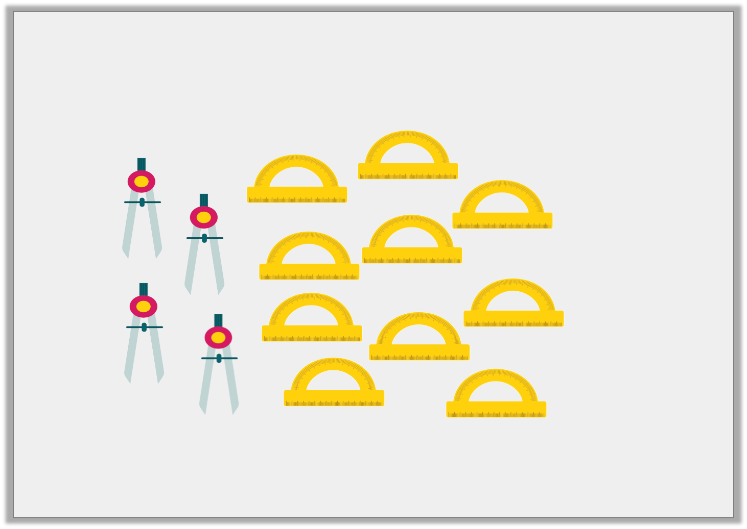
Problem Solving 2
Write an algebraic expression to show how many protractors there are if compasses equals c.
© Classroom Secrets Limited 2019

Slide 16
Problem Solving 2
Write an algebraic expression to show how many protractors there are if compasses equals c.
Various possible answers; for example: c + 6, 2.5c, c x .
5
2
© Classroom Secrets Limited 2019

Slide 17
Reasoning 1
Four of the cards are inputs or outputs of the function machine.
Circle the odd one out.
Explain your reasoning.
6.2
27
12
18.6
9
?
÷ 3
?
© Classroom Secrets Limited 2019

Slide 18
Reasoning 1
Four of the cards are inputs or outputs of the function machine.
Circle the odd one out.
Explain your reasoning.
12 is the odd one out because…
6.2
27
12
18.6
9
?
÷ 3
?
© Classroom Secrets Limited 2019

Slide 19
Reasoning 1
Four of the cards are inputs or outputs of the function machine.
Circle the odd one out.
Explain your reasoning.
12 is the odd one out because 18.6 ÷ 3 = 6.2 and 27 ÷ 3 = 9.
12 ÷ 3 = 4 and 36 ÷ 3 = 12 but there is not a number card for 4 or 36.
6.2
27
12
18.6
9
?
÷ 3
?
© Classroom Secrets Limited 2019

