Slide 1
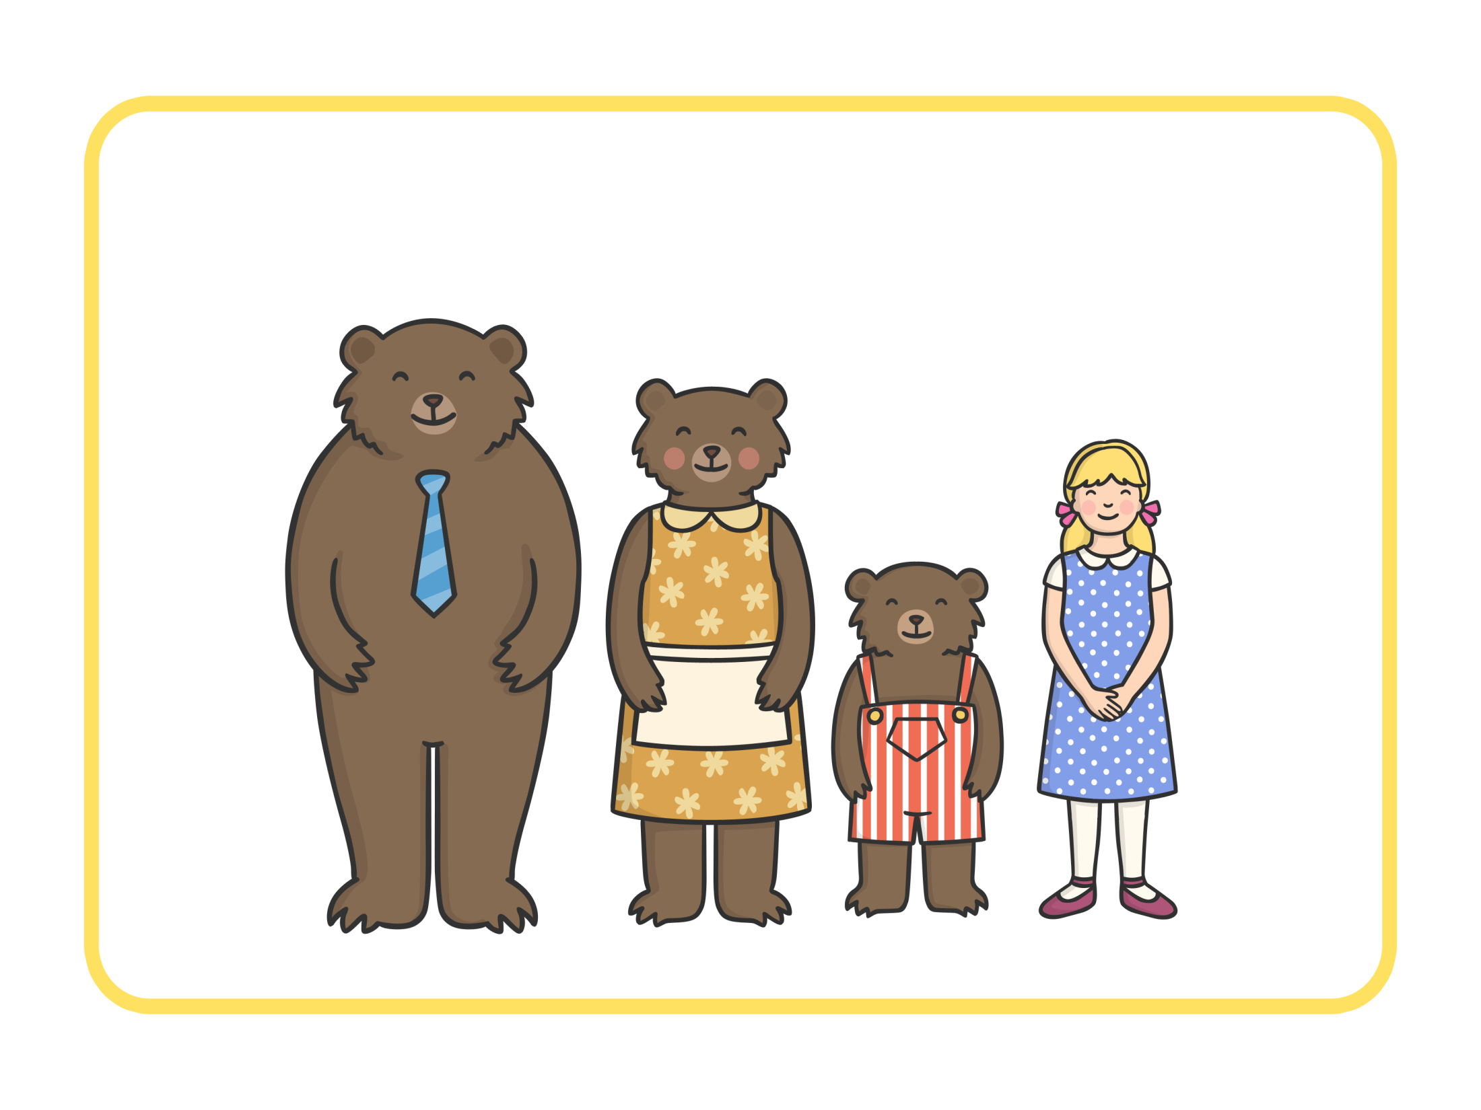

Goldilocks and the Three Bears

Slide 2
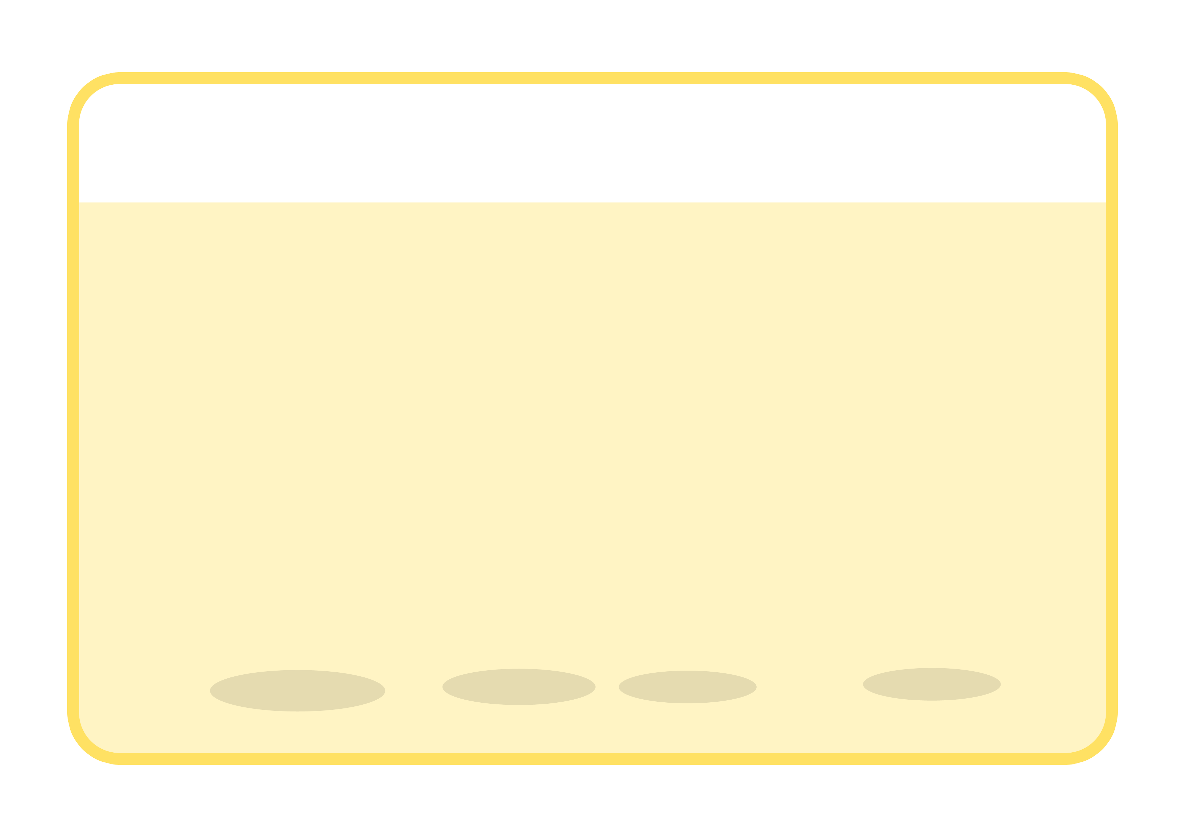
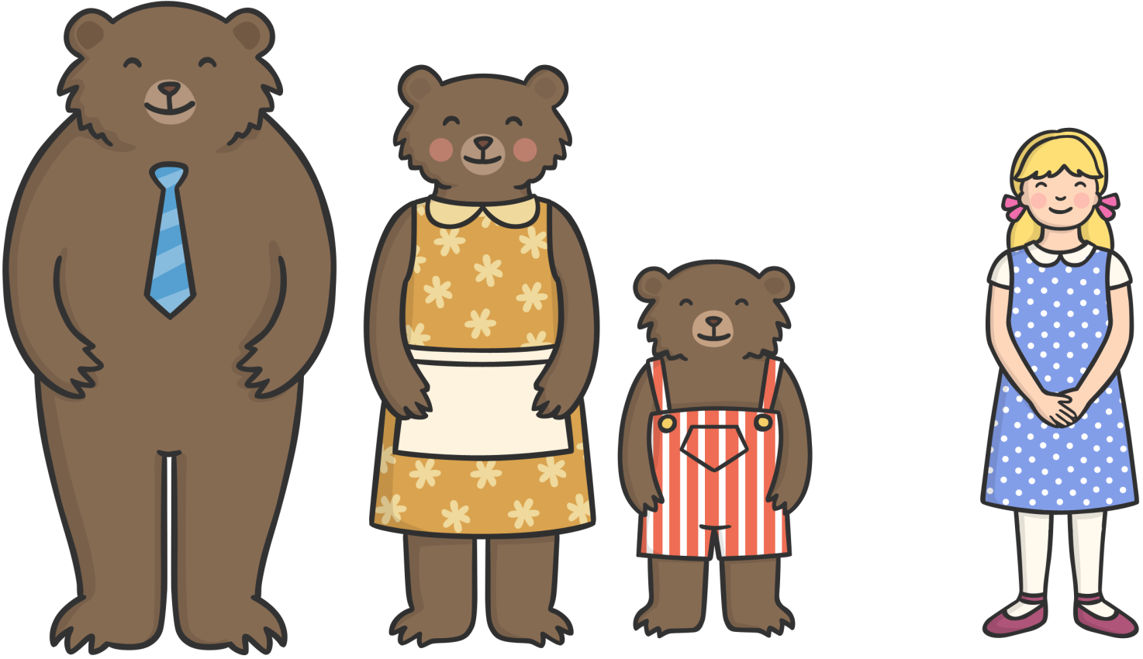

Once upon a time lived Goldilocks and The Three Bears.

Slide 3
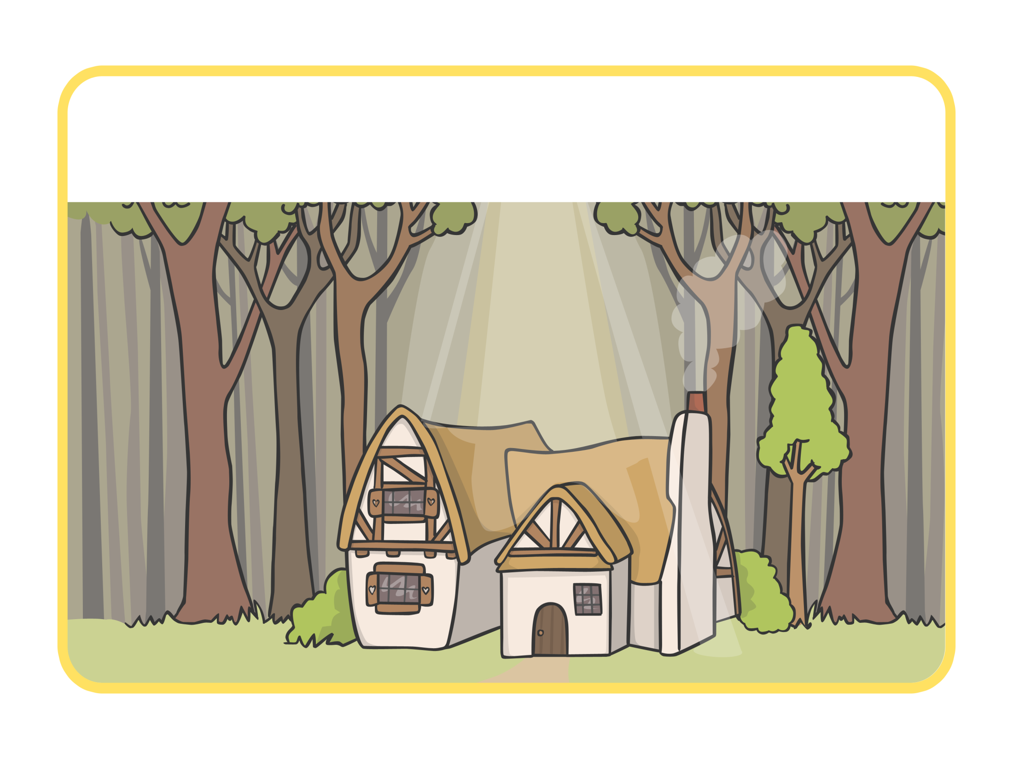
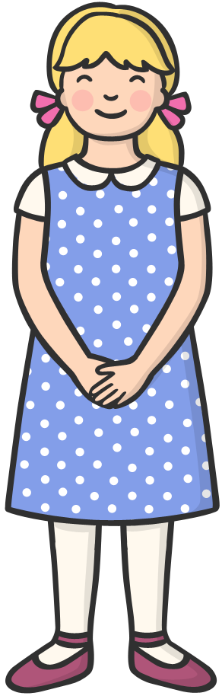
One day, Goldilocks went for a walk in the forest and found a house. She knocked, and when nobody answered, she decided to go inside.

Slide 4
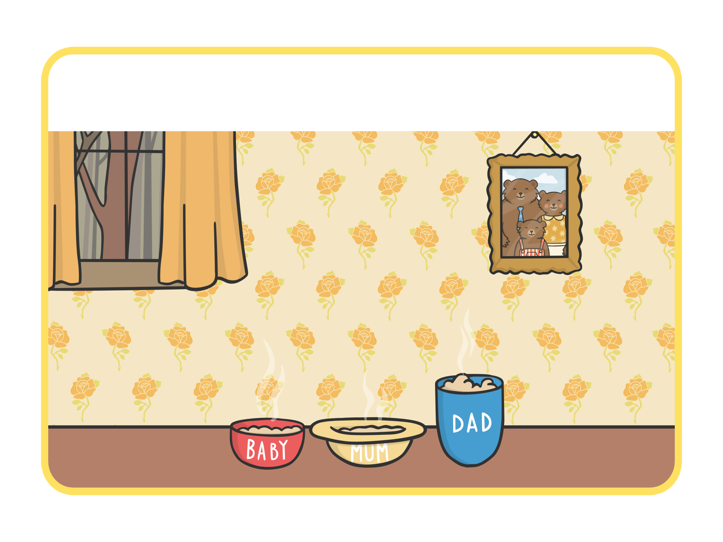
At the table, there were three bowls of porridge. Goldilocks was hungry.

Slide 5
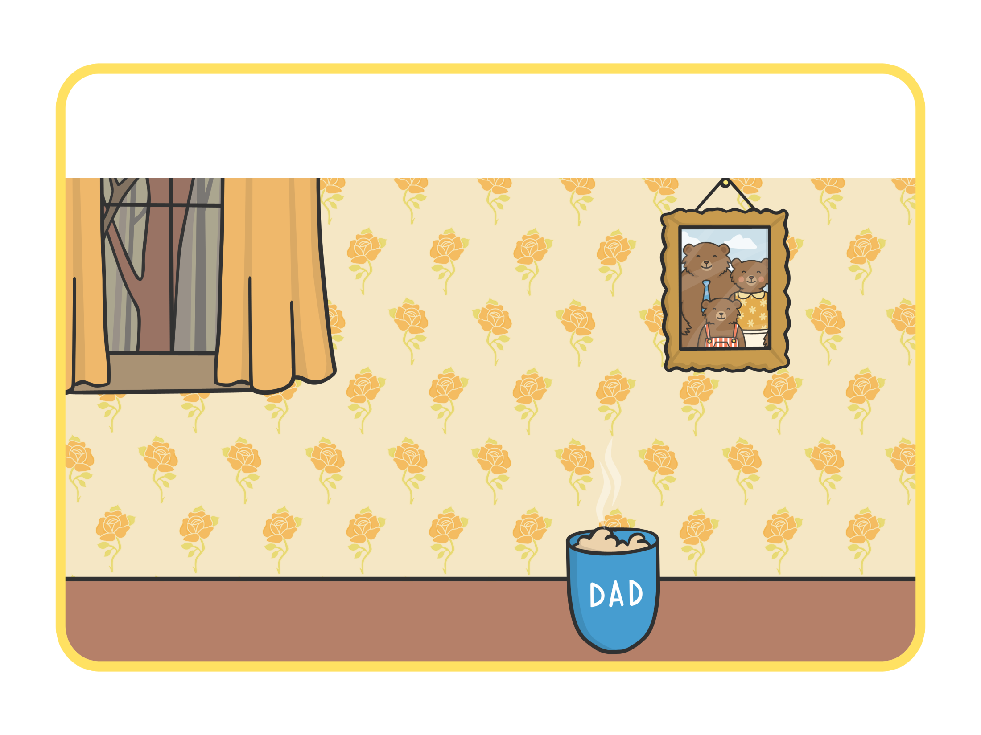
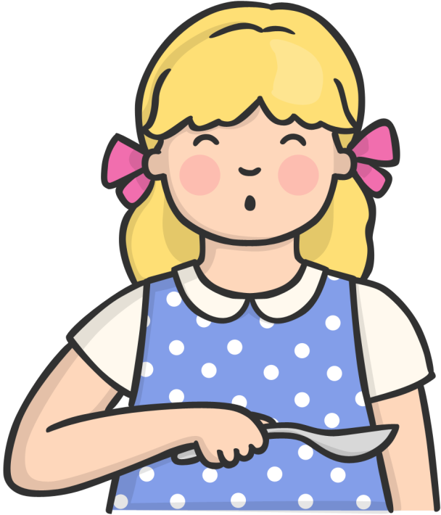
She tasted the porridge from the large bowl. “This porridge is too salty!” she said.

Slide 6
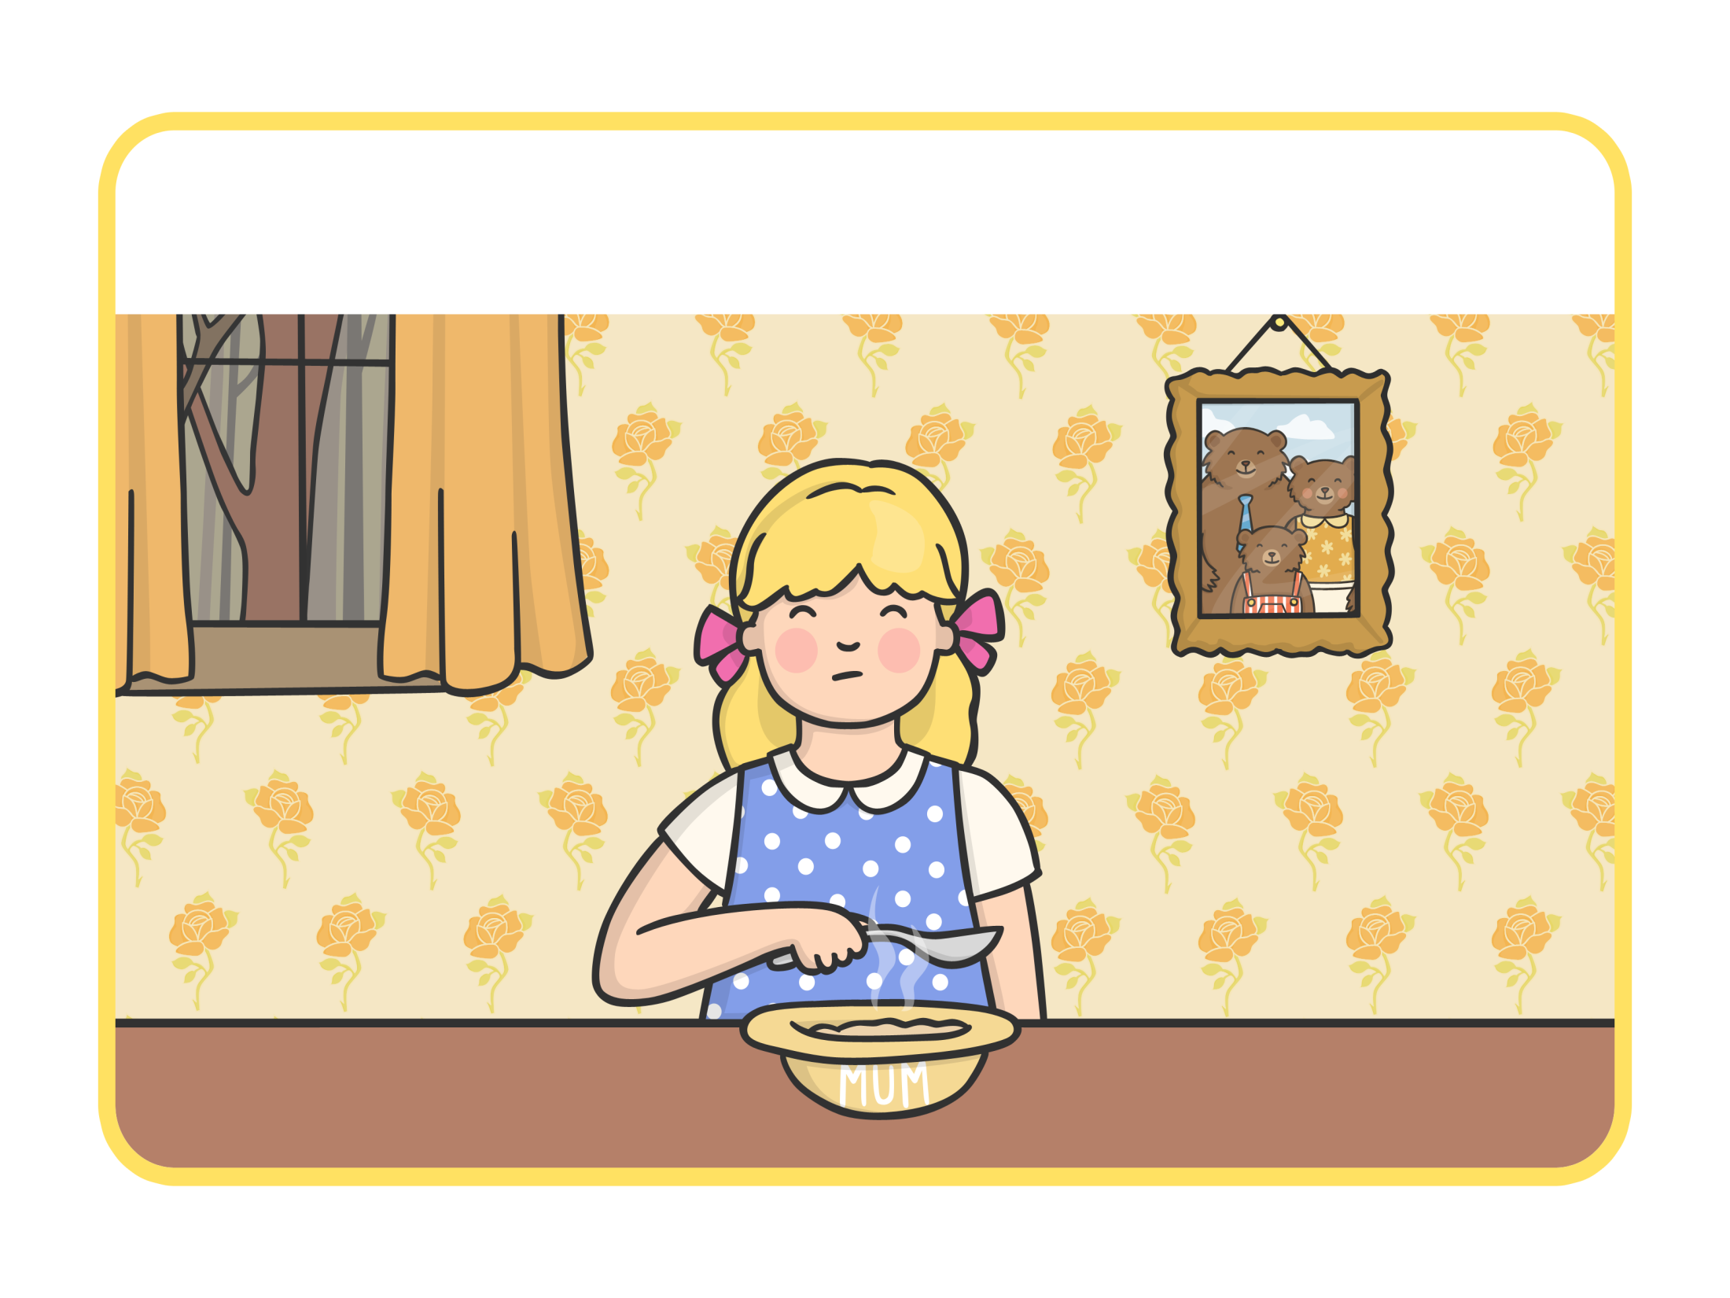
She tasted the porridge from the medium sized bowl. “This porridge is too sweet!” she said.

Slide 7
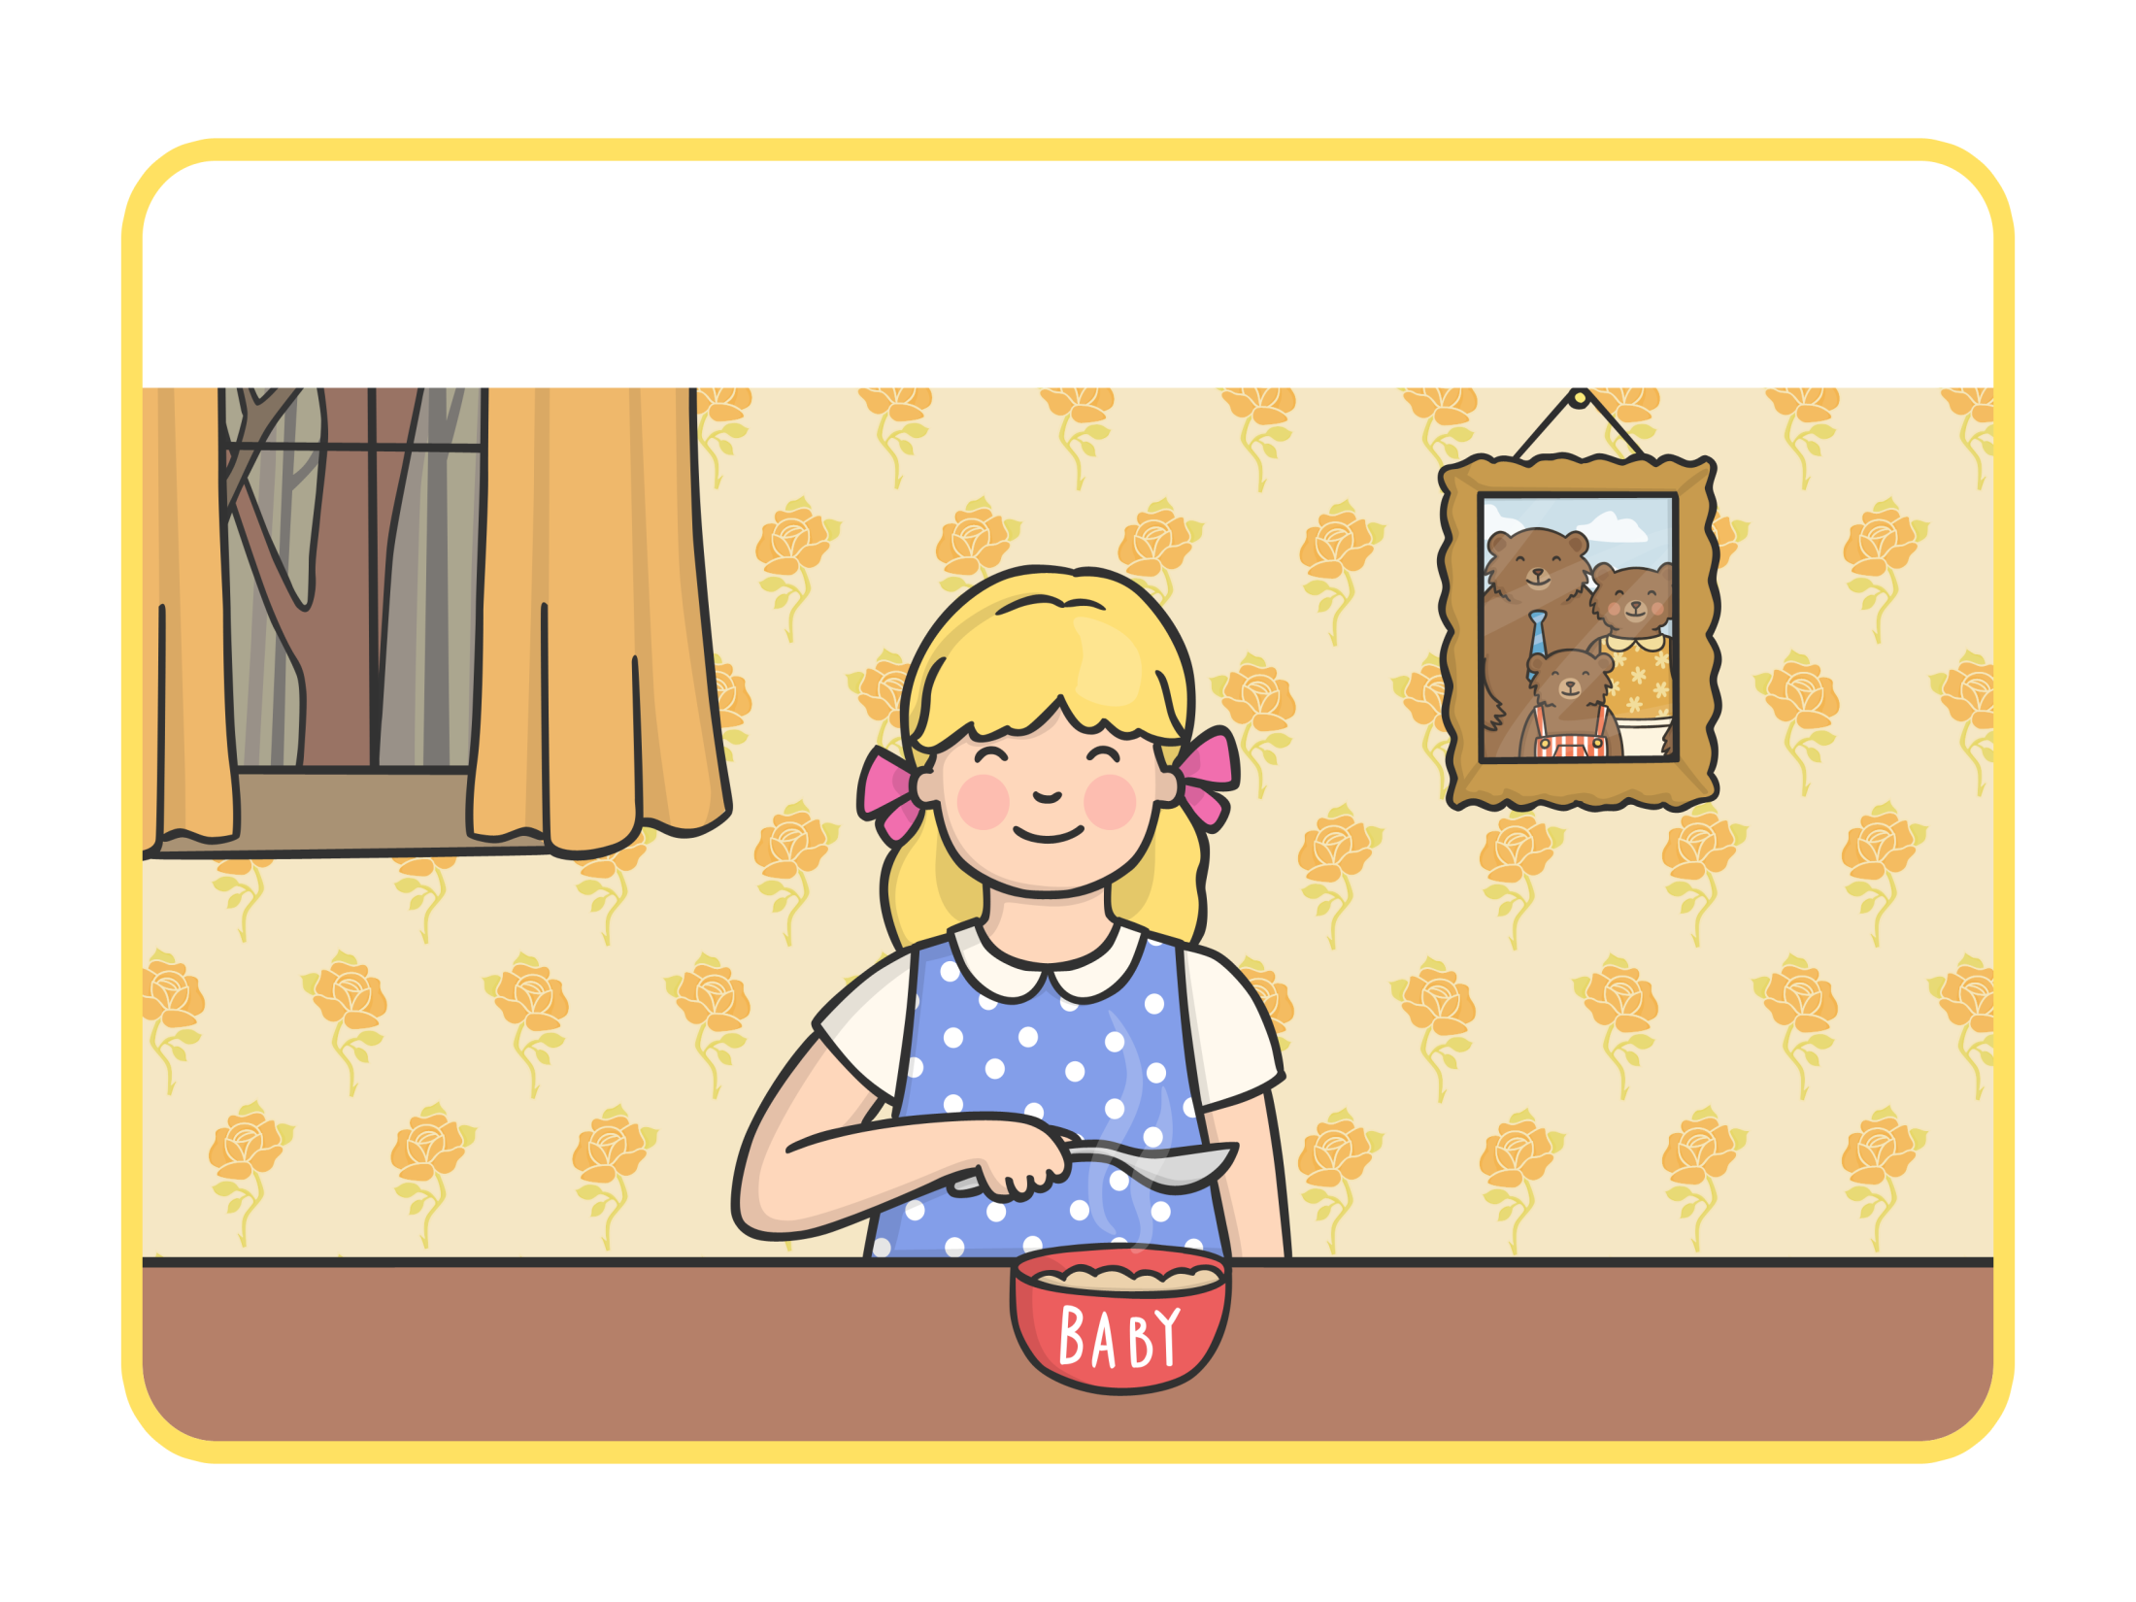
She tasted the porridge from the small bowl. “This porridge is just right,” she said and she ate it all up.

Slide 8
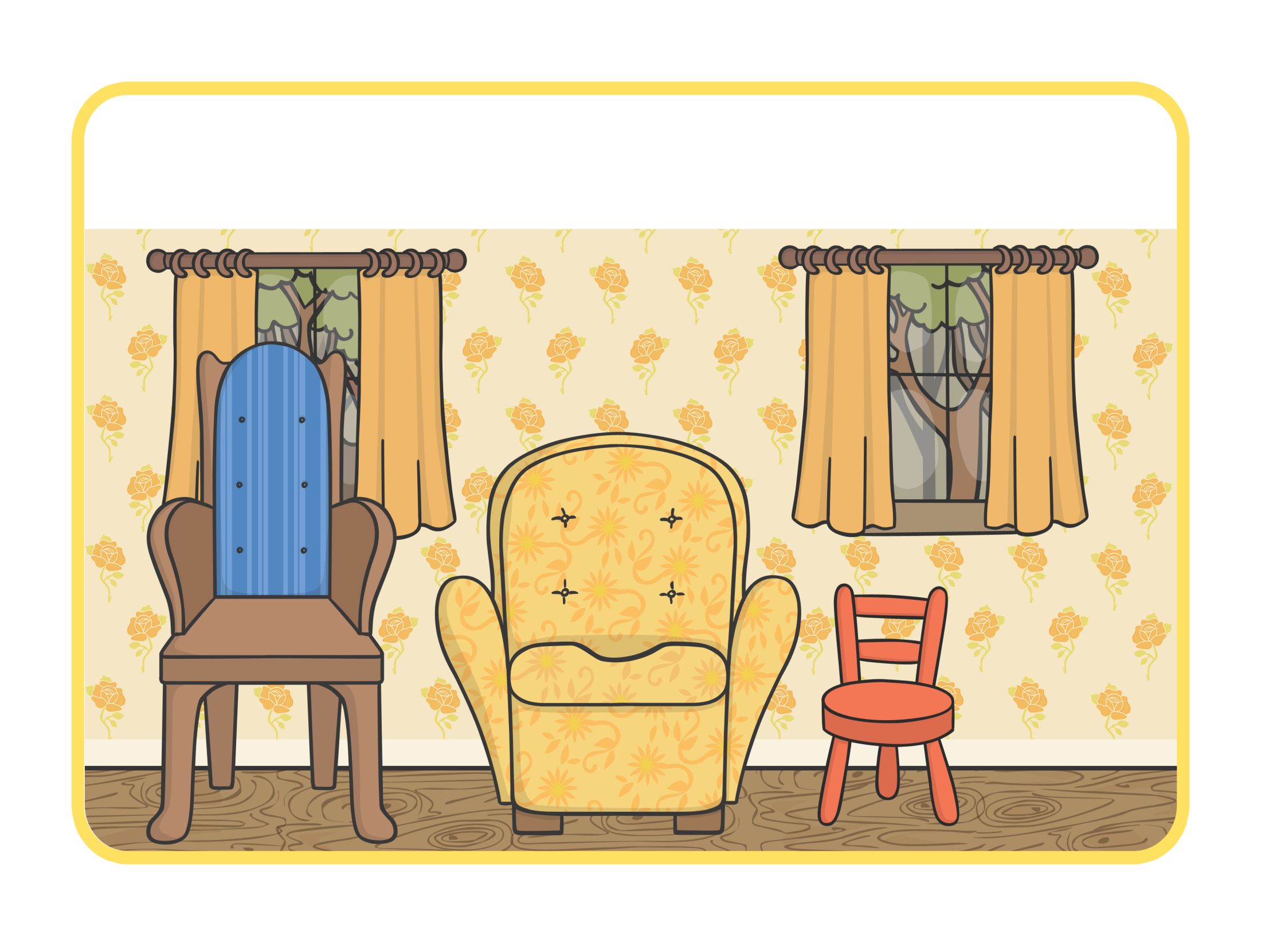

Goldilocks felt tired, so she walked into the living room and saw three chairs.

Slide 9
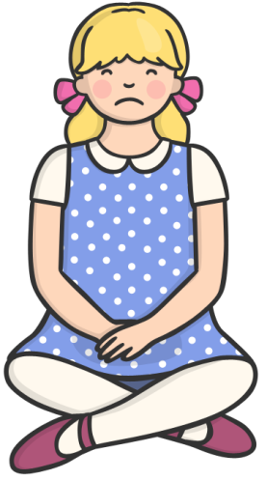
She sat in the large chair to rest her feet. “This chair is too big!” she said.

Slide 10
She sat in the medium sized chair. “This chair is too big, too!” she said.

Slide 11
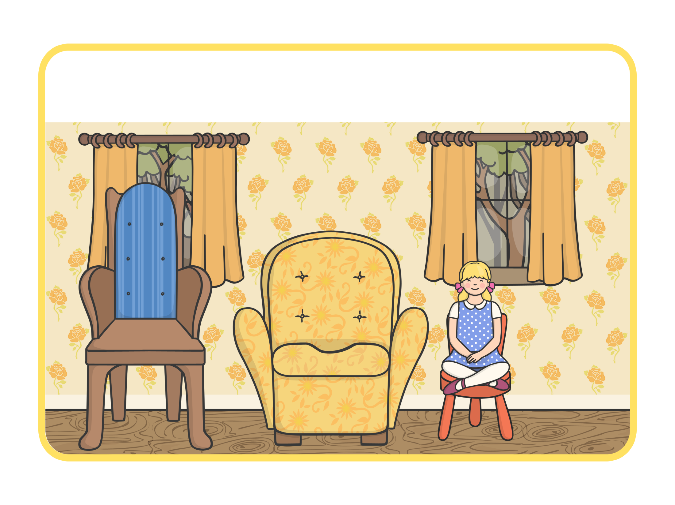
She sat in the small chair. “This chair is just right,” she sighed.

Slide 12
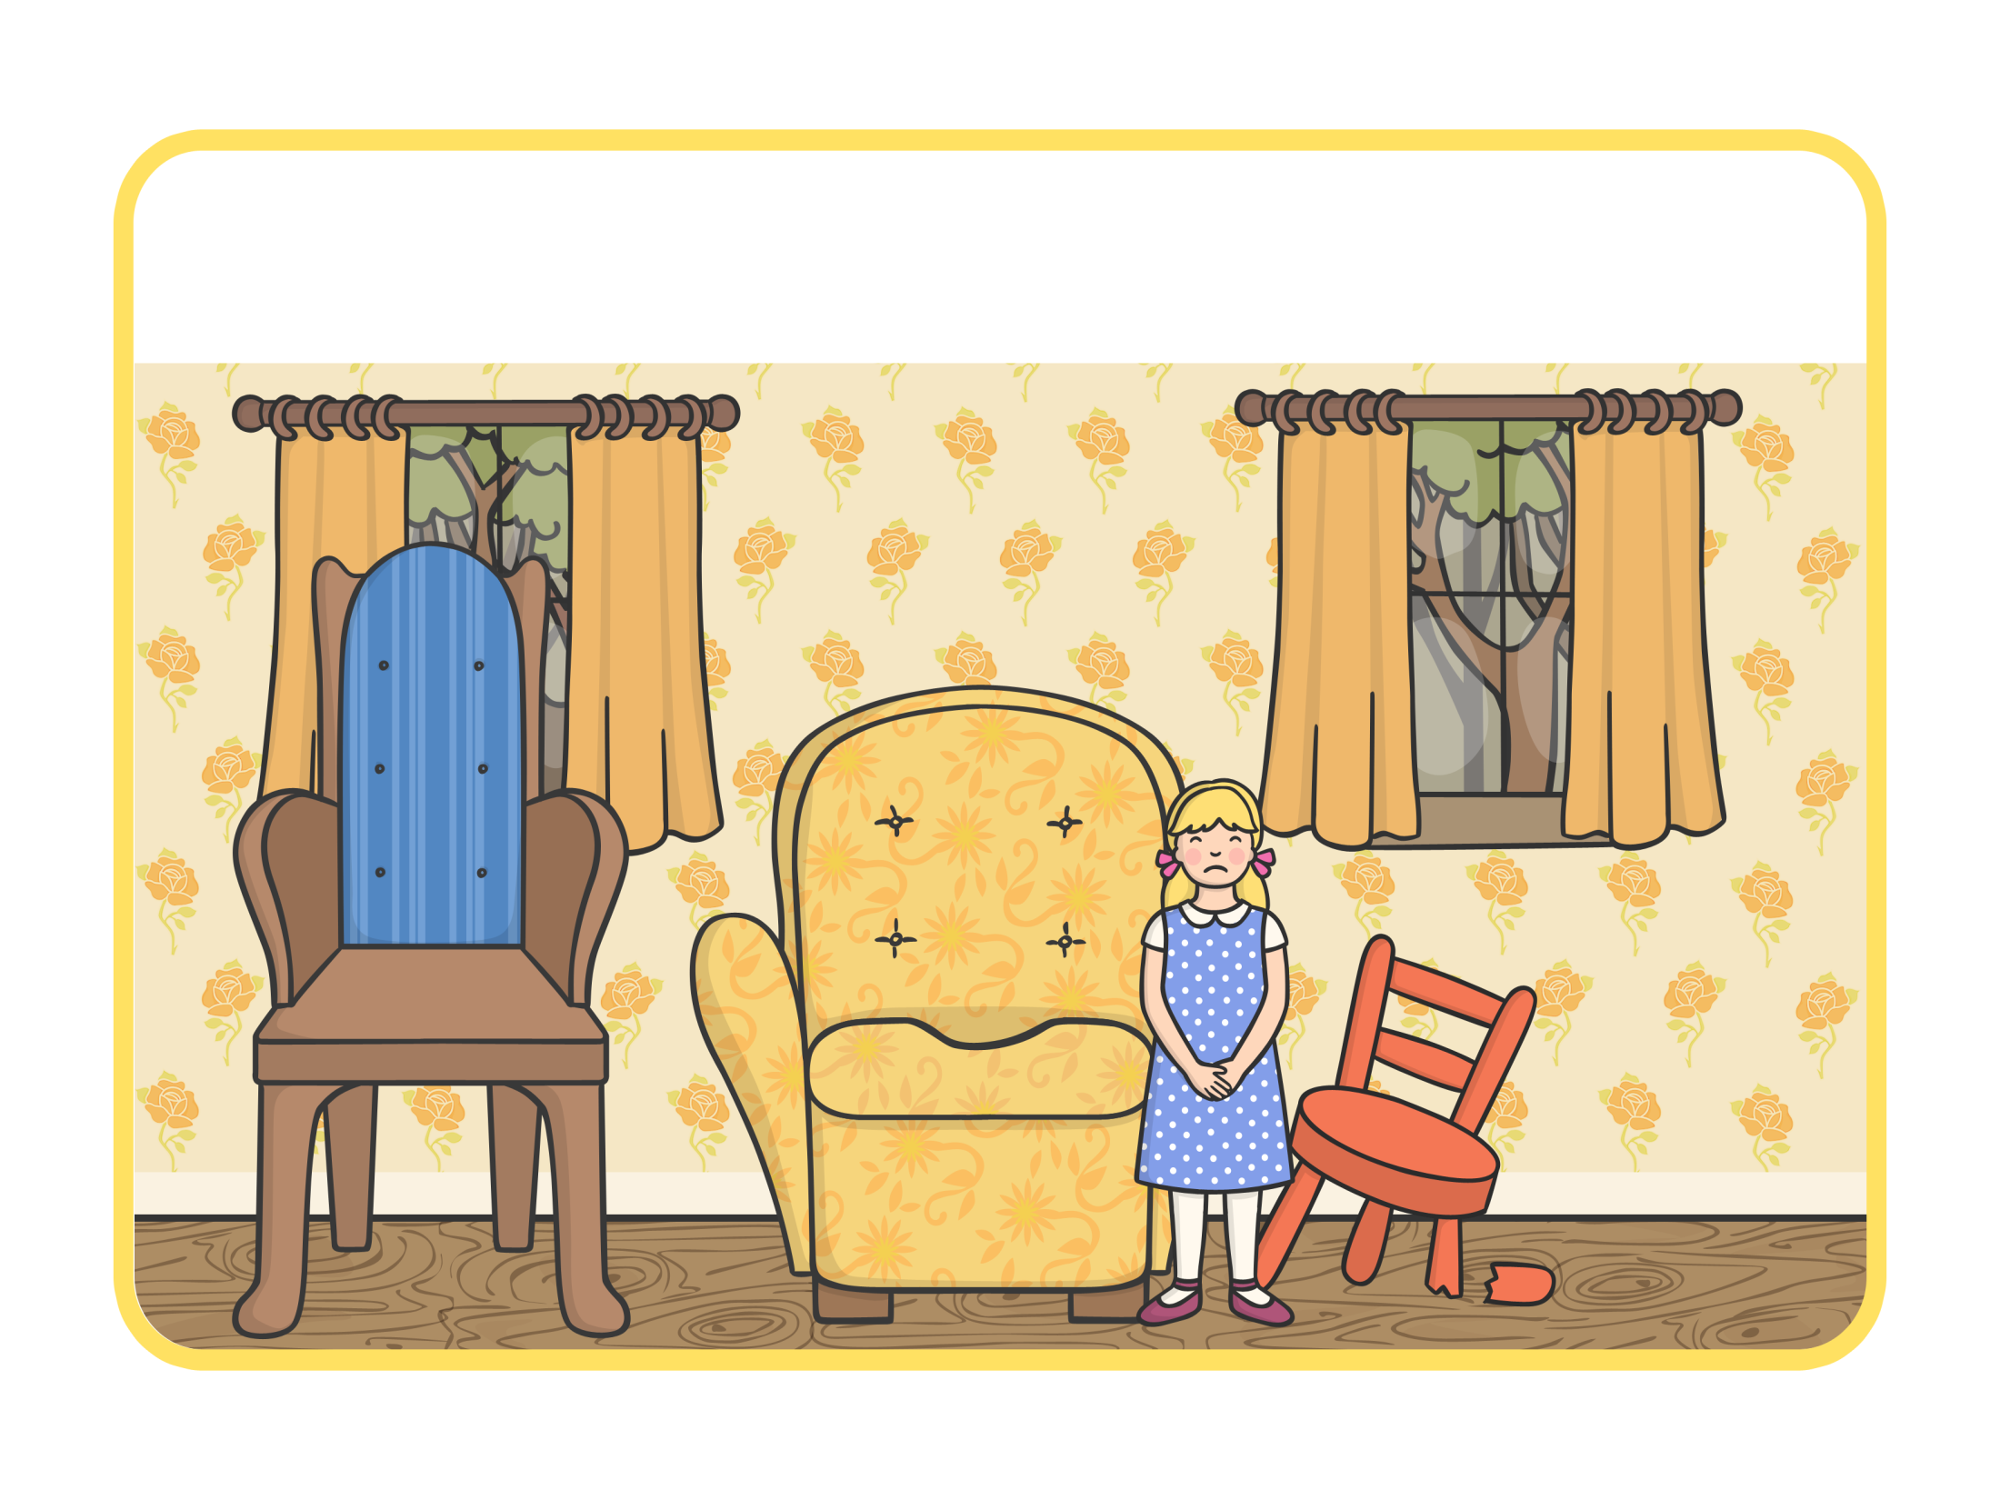
Just as Goldilocks settled down into the chair to rest, it broke into pieces!

Slide 13
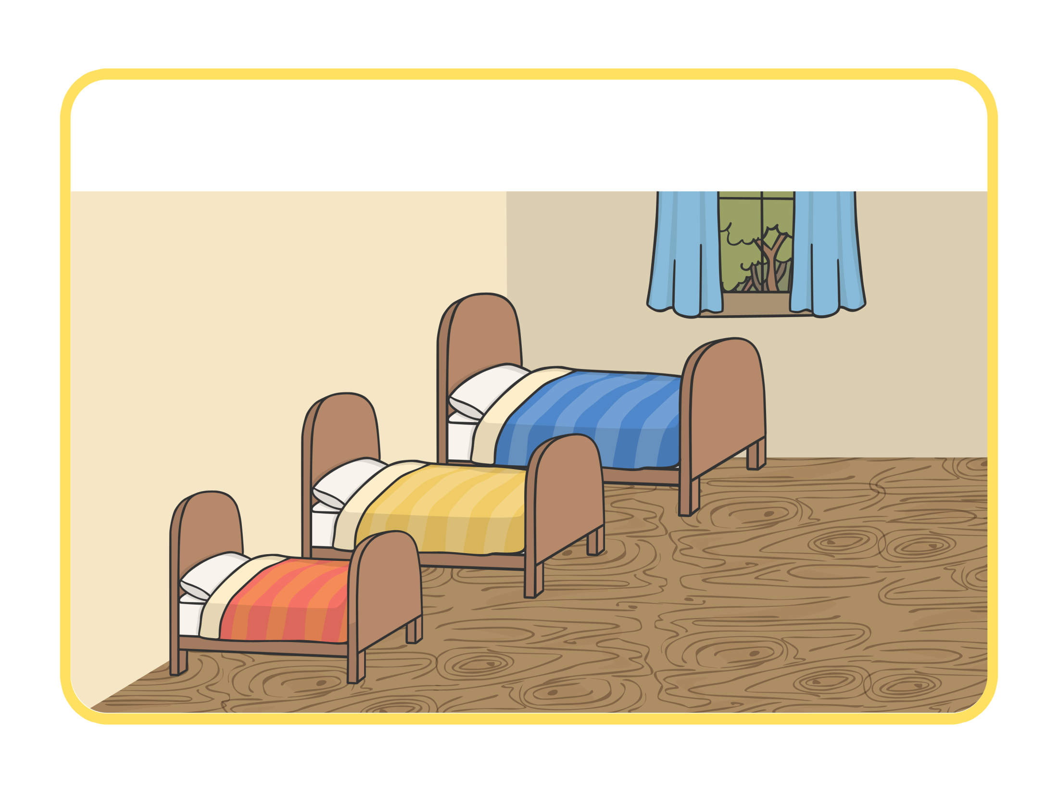
By now, Goldilocks was very tired, so she went upstairs to the bedroom.

Slide 14
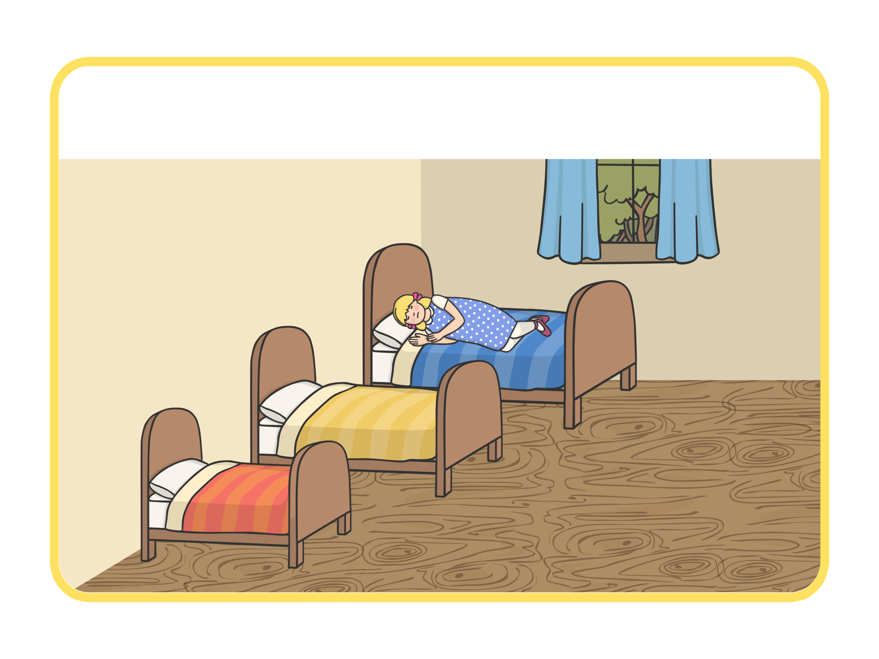
She lay down on the large bed. “This bed is too hard!” she said.

Slide 15
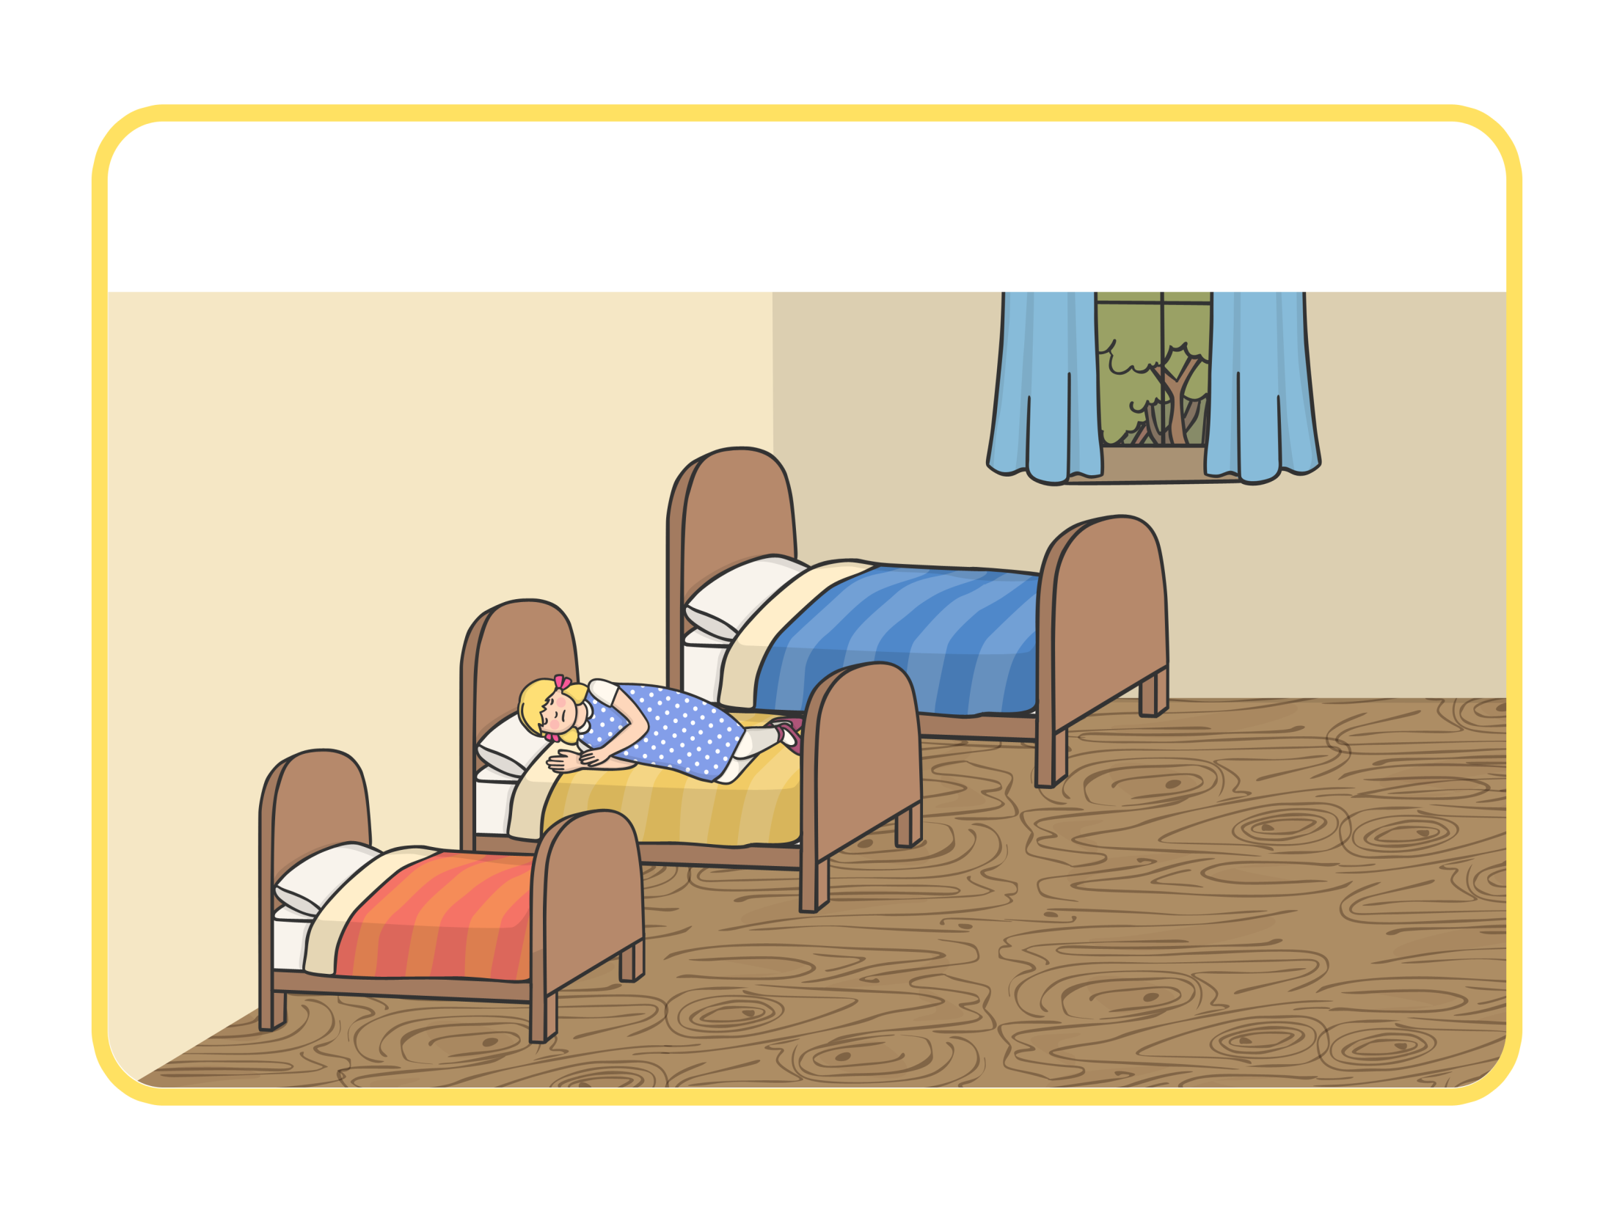
Then she lay on the medium sized bed. “This bed is too soft!” she said.

Slide 16
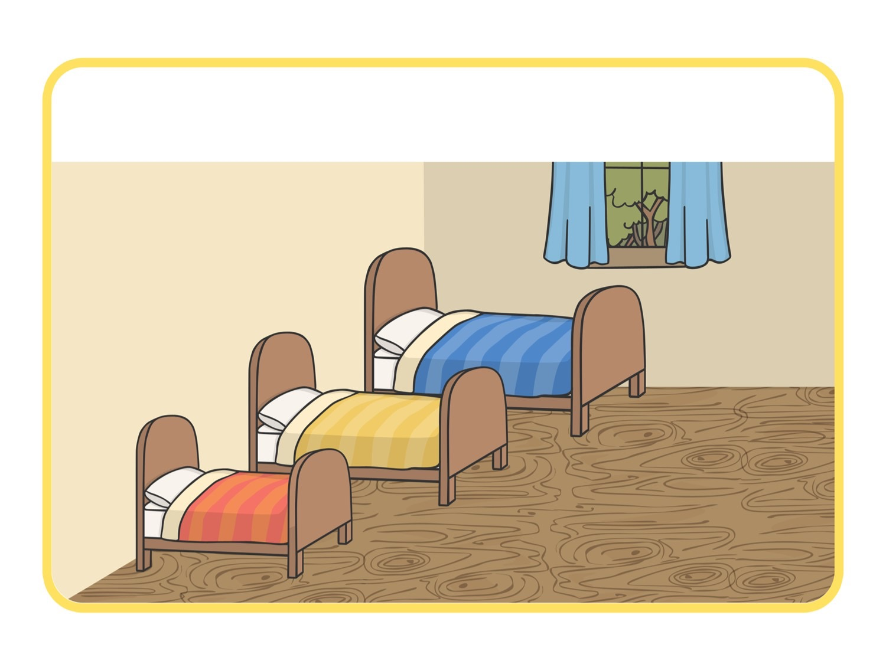
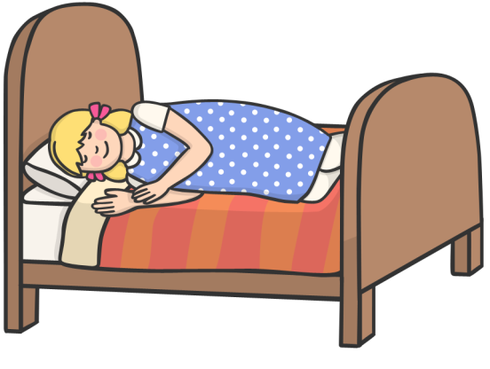
So she lay down on the small bed. “This bed is just right,” she said, and Goldilocks fell asleep.

Slide 17
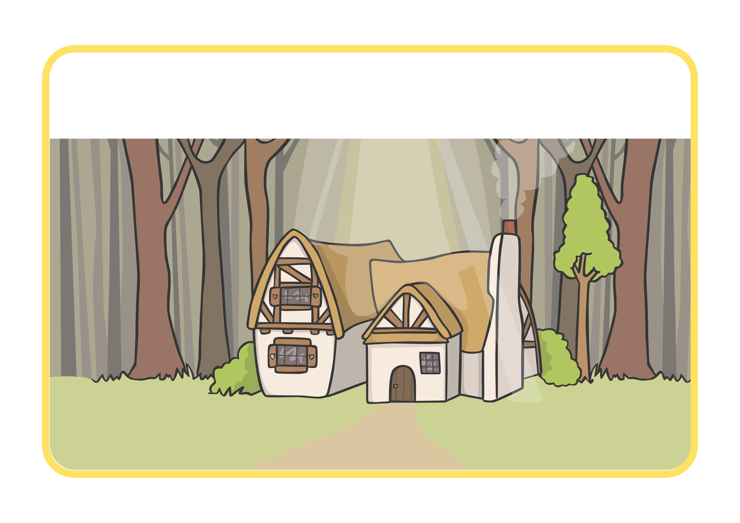
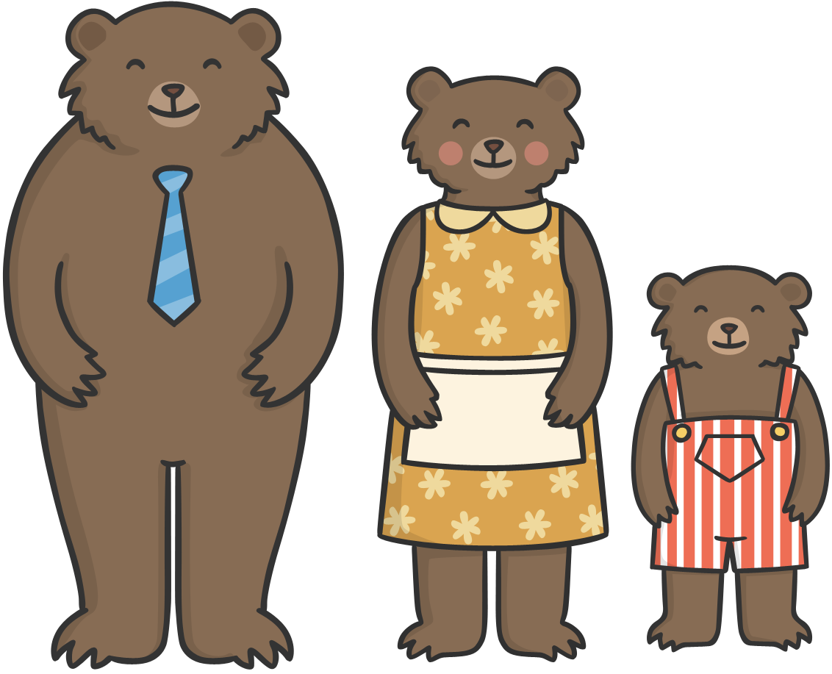
As she was sleeping, The Three Bears came home.

Slide 18
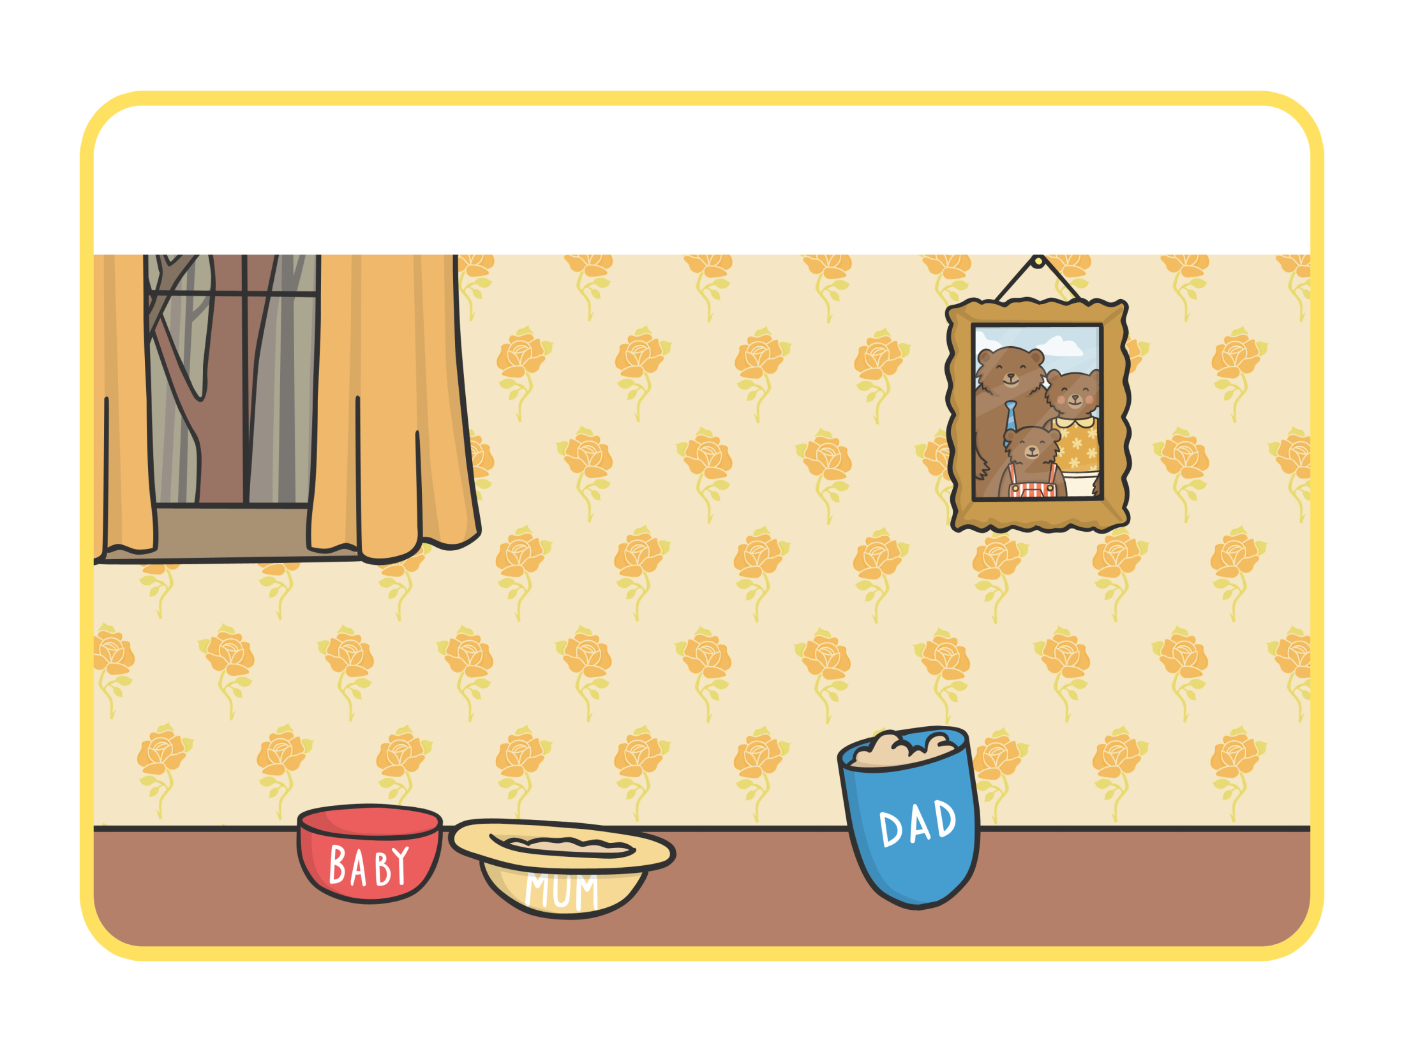

“Someone’s been eating my porridge,” growled Daddy Bear.

Slide 19
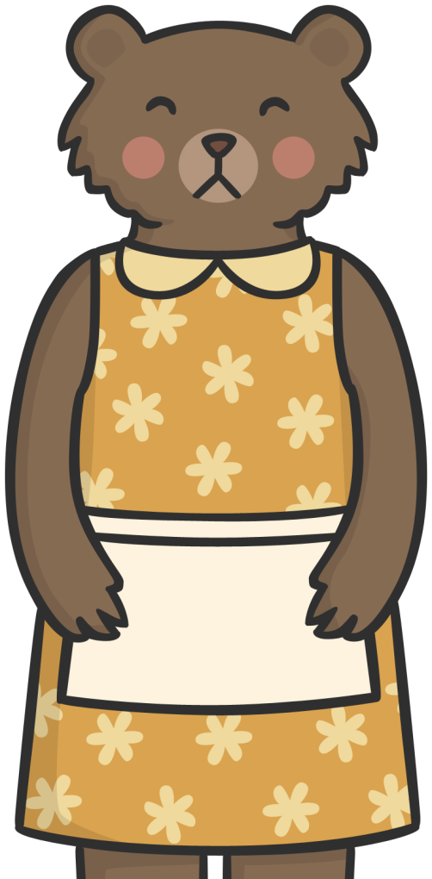
“Someone’s been eating my porridge,” said Mummy Bear.

Slide 20
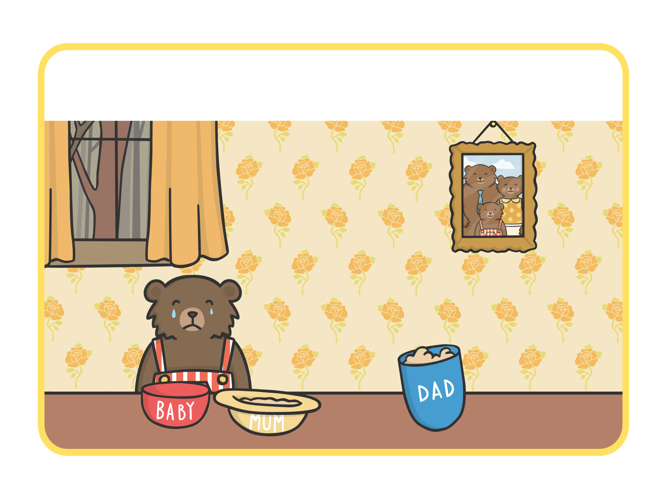
“Someone’s been eating my porridge and it’s all gone!” cried Baby Bear.

Slide 21
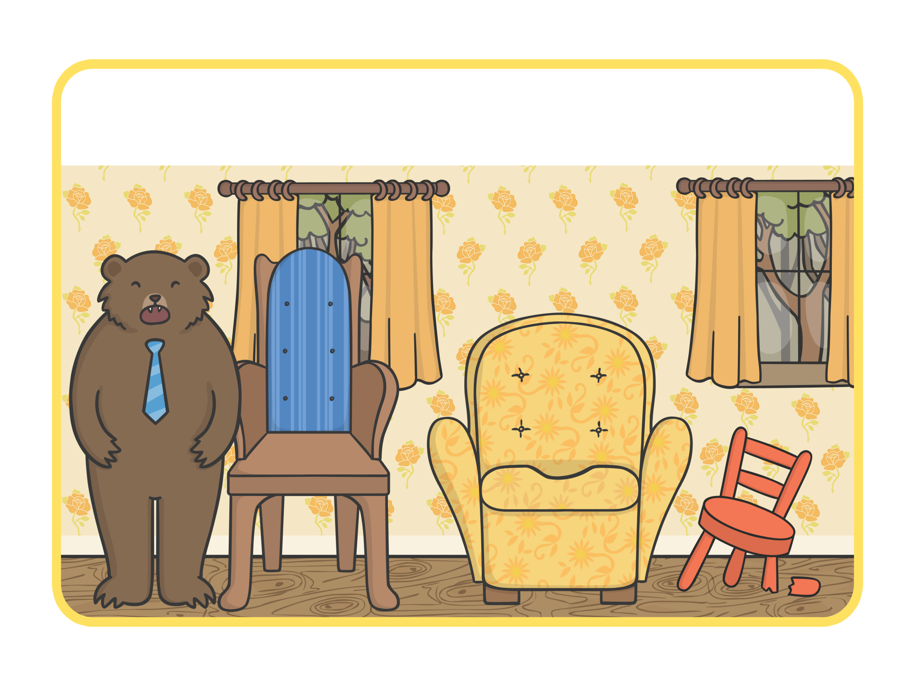
“Someone’s been sitting in my chair!” growled Daddy Bear.

Slide 22
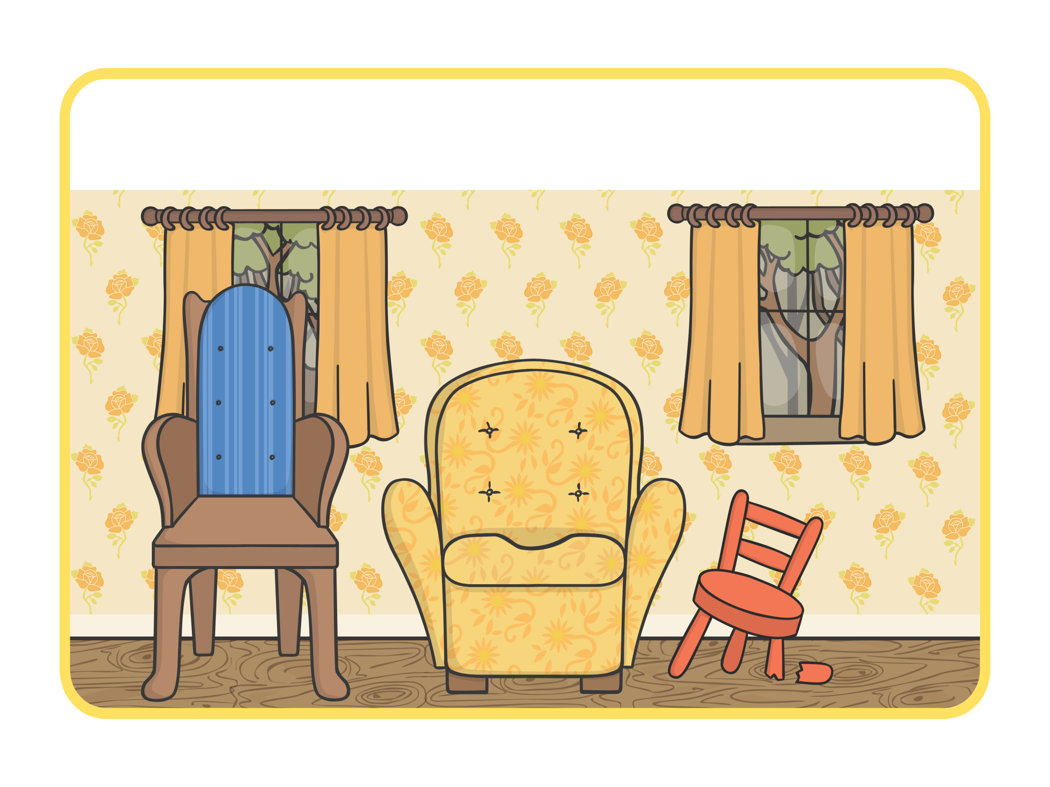
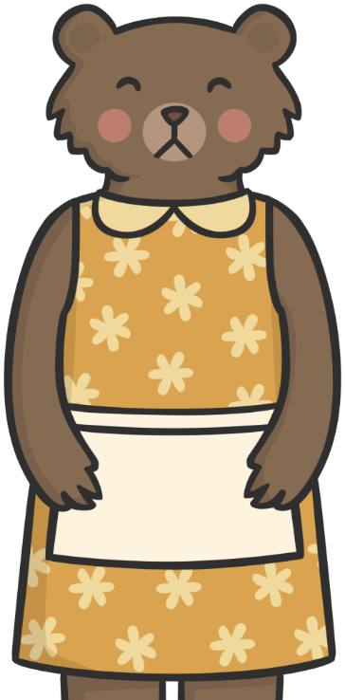
“Someone’s been sitting in my chair!” said Mummy Bear.

Slide 23
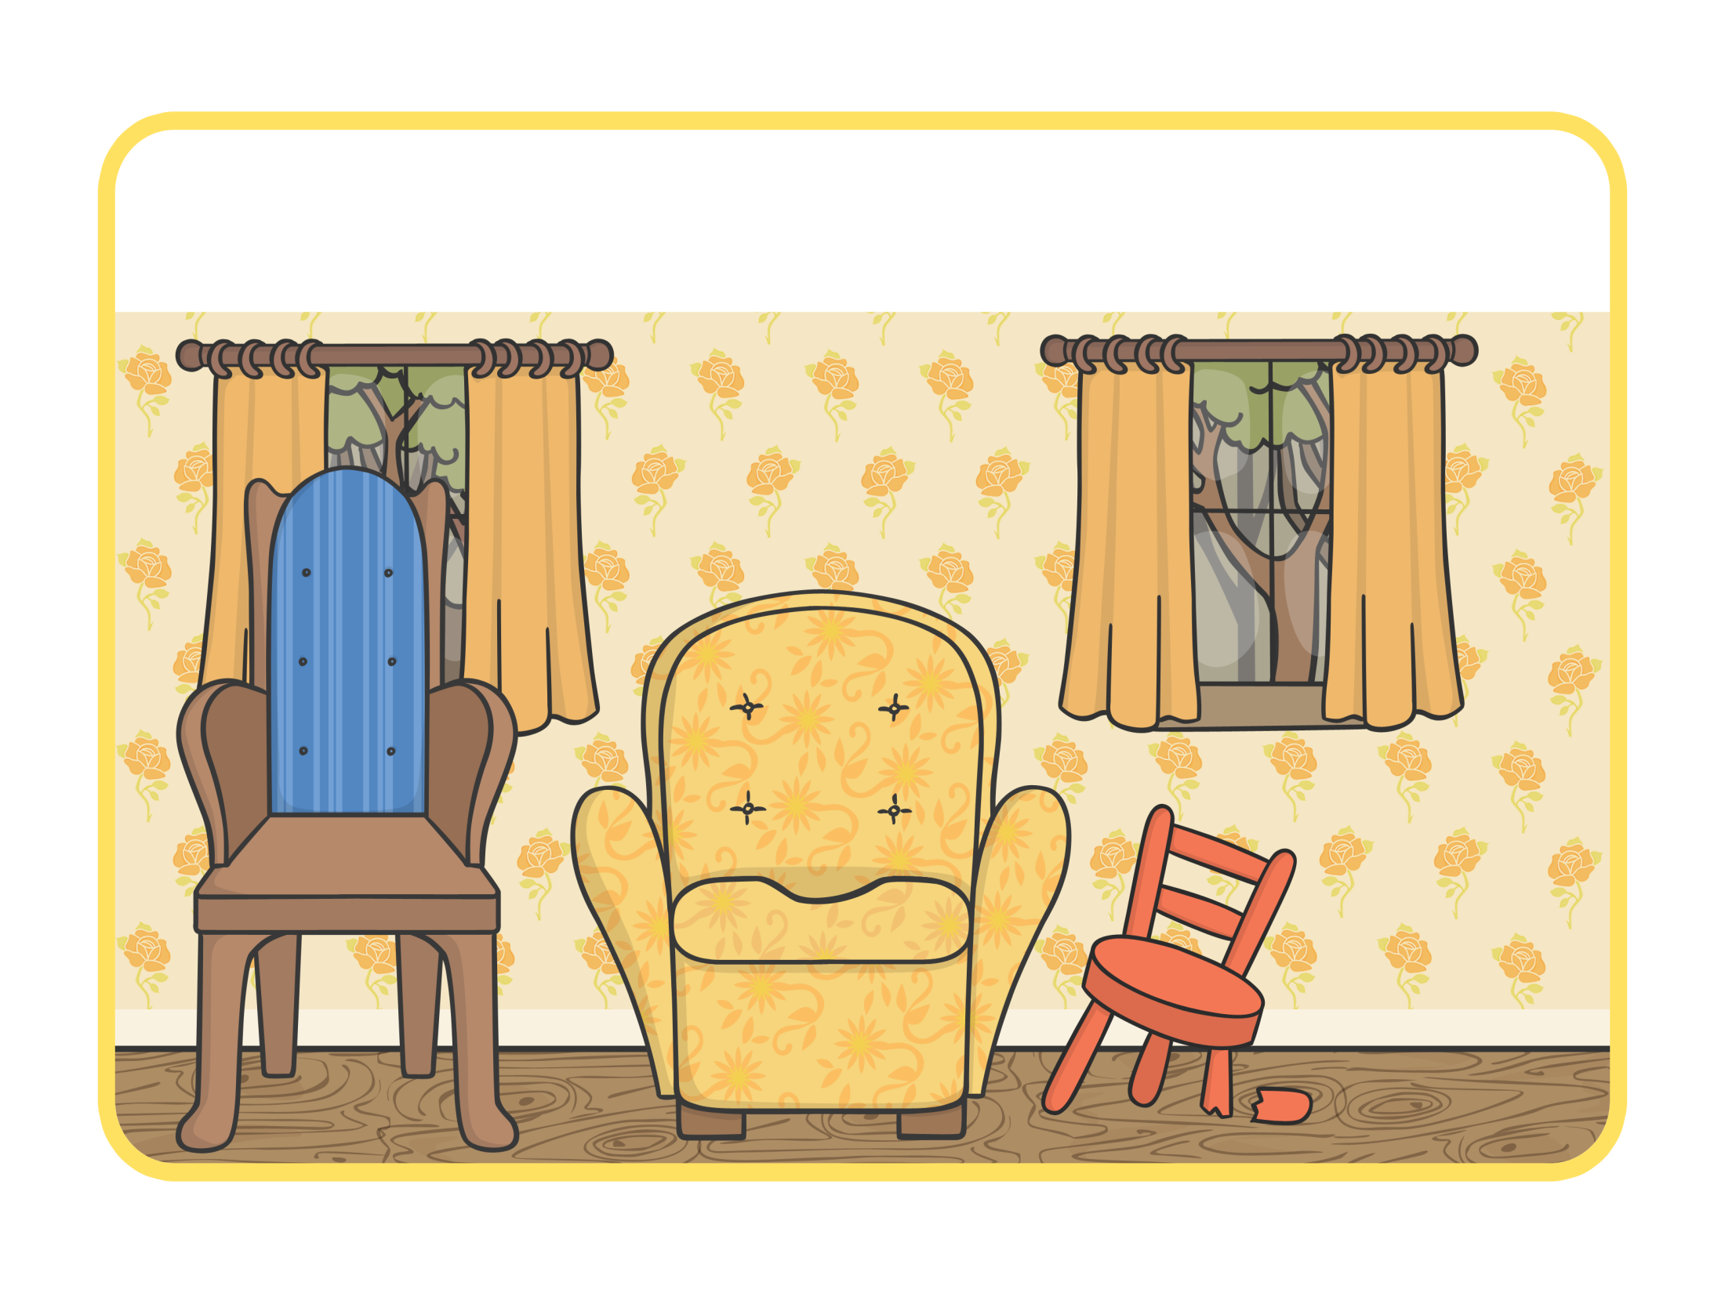
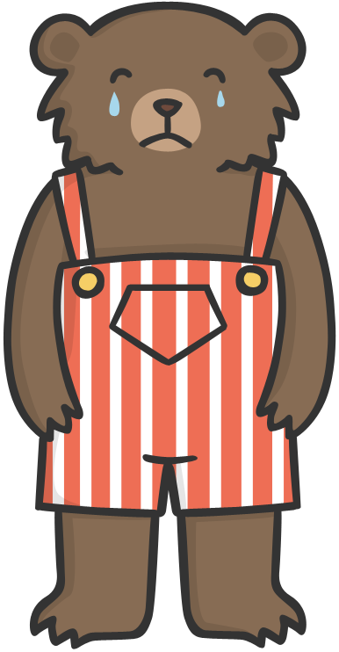
“Someone’s been sitting in my chair and it’s broken!” cried Baby Bear.

Slide 24
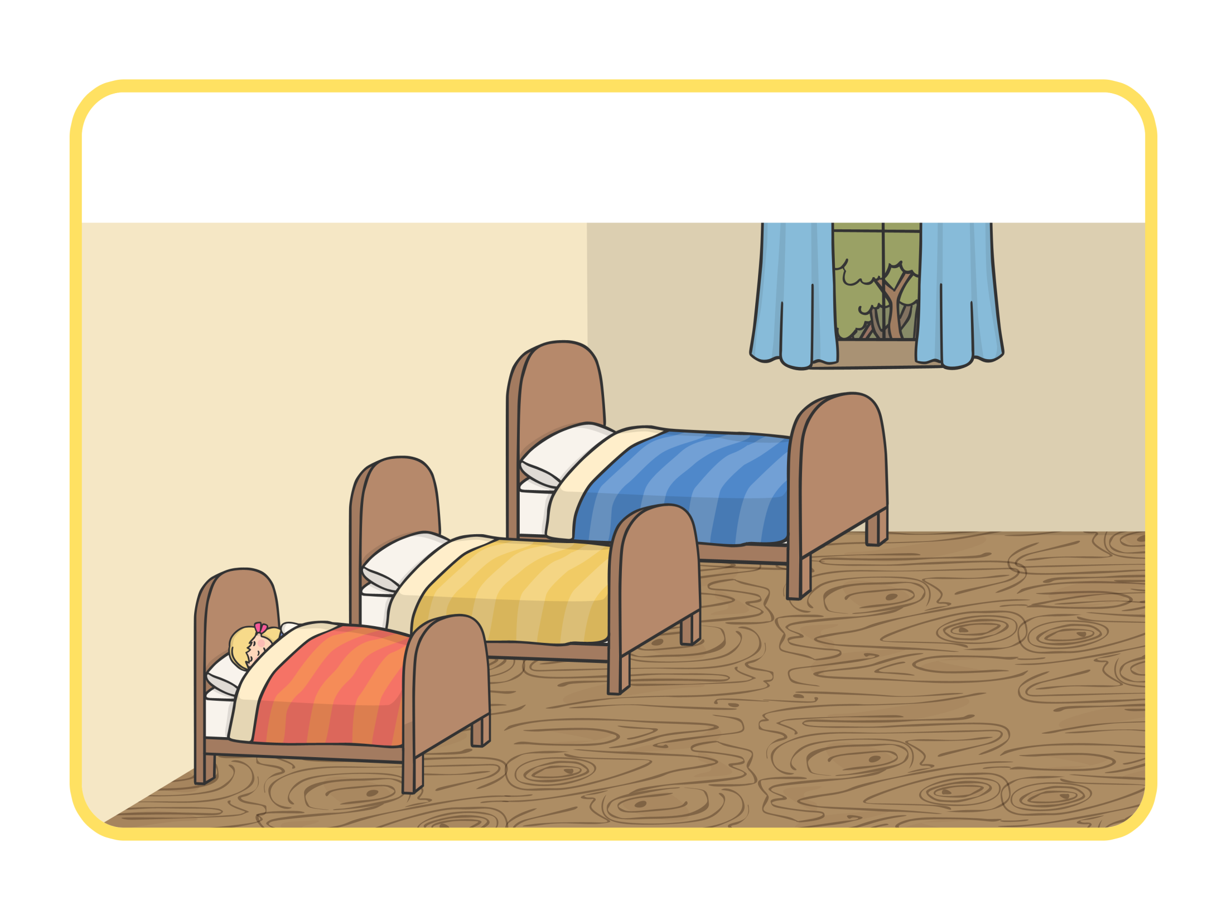

When they got upstairs to the bedroom, Daddy Bear growled, “Someone’s been sleeping on my bed.”

Slide 25
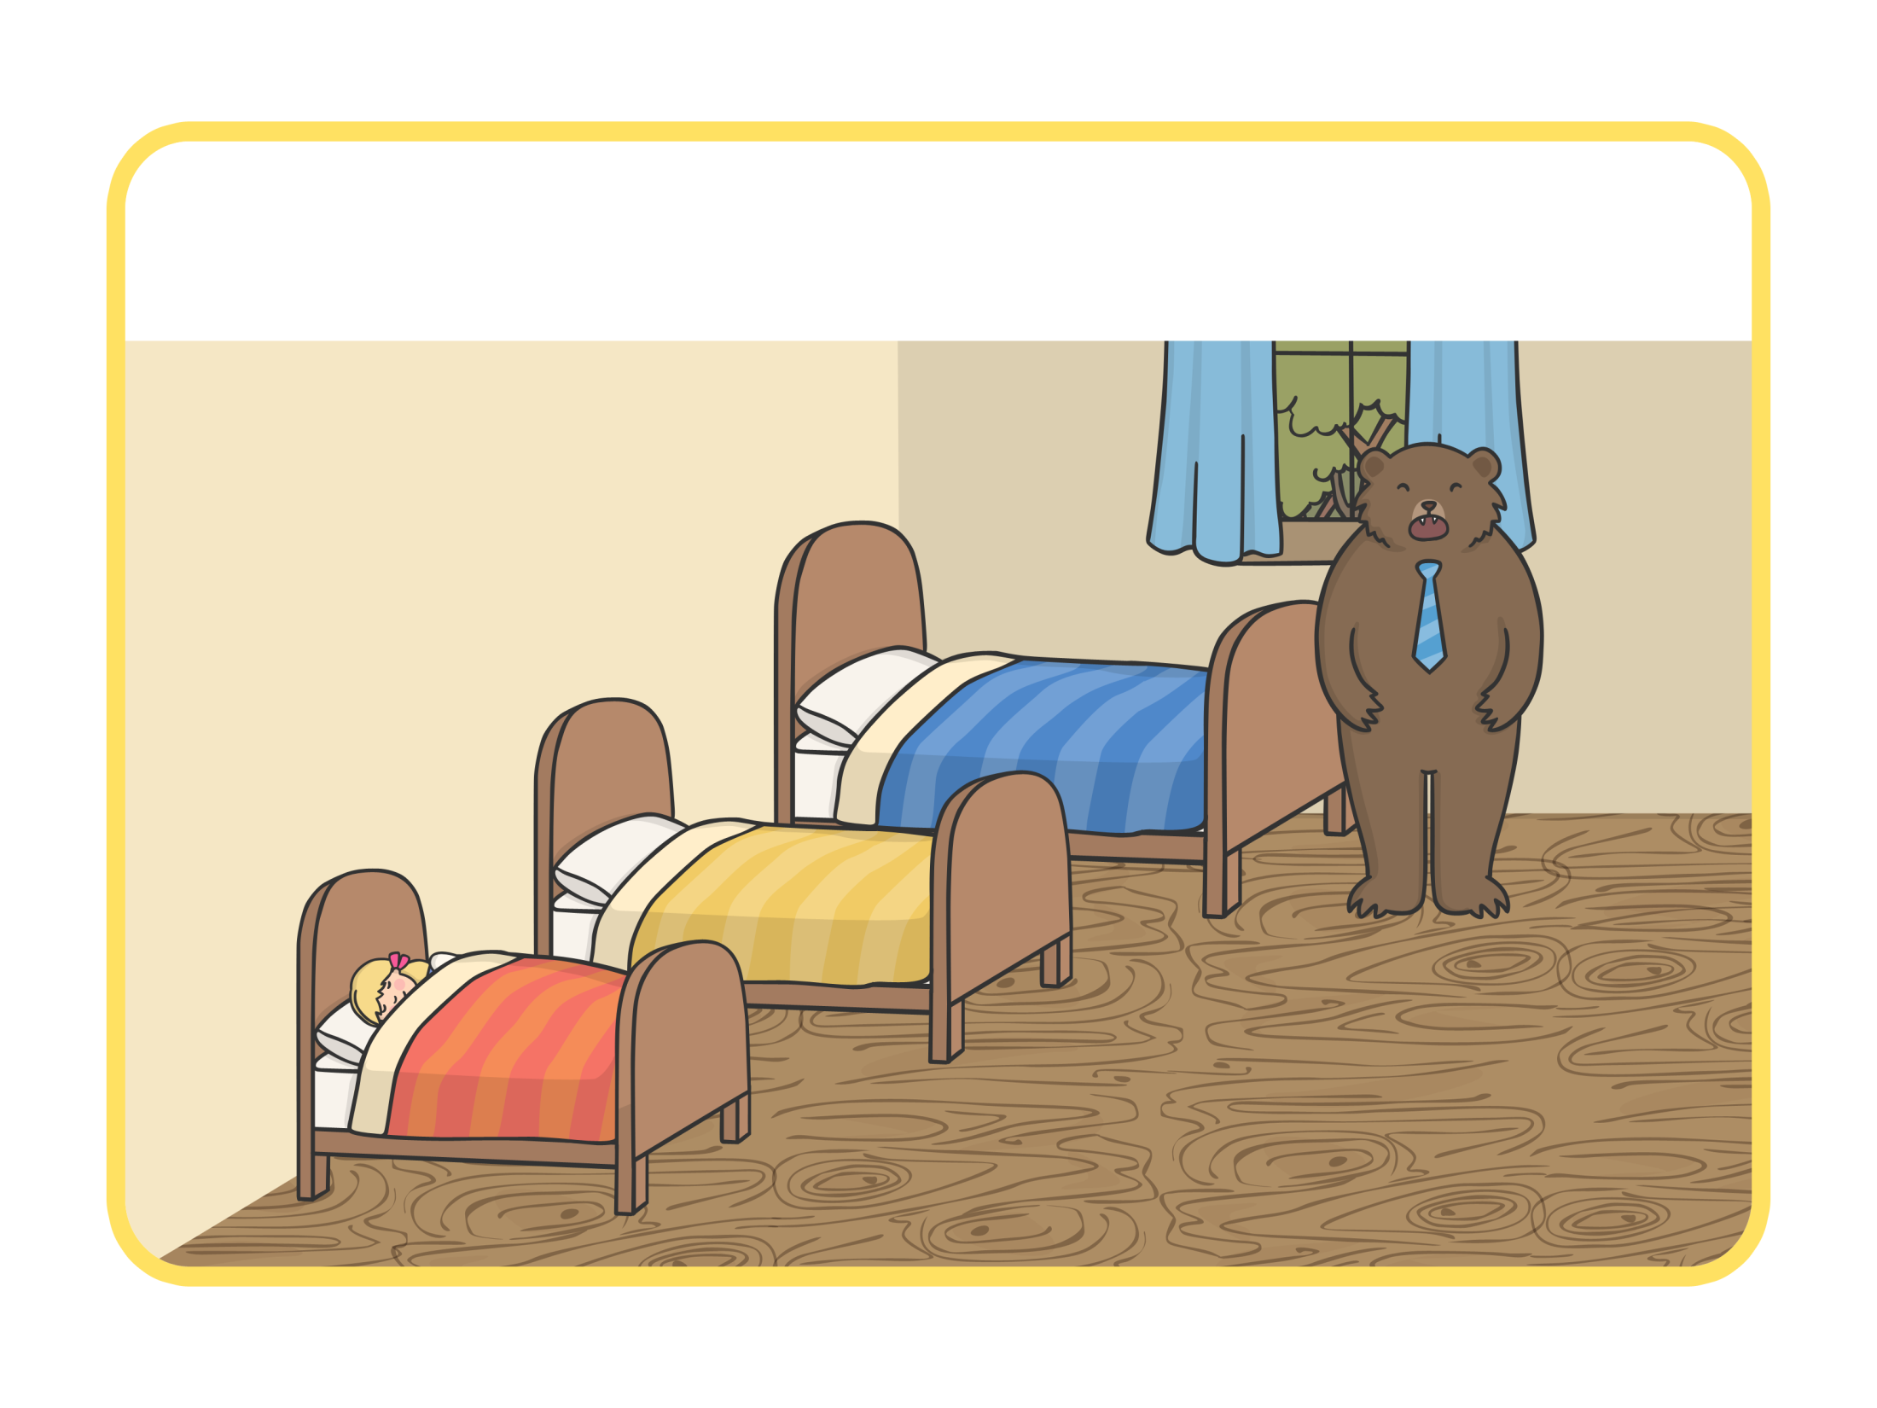

“Someone’s been sleeping on my bed too,” said the Mummy Bear

Slide 26
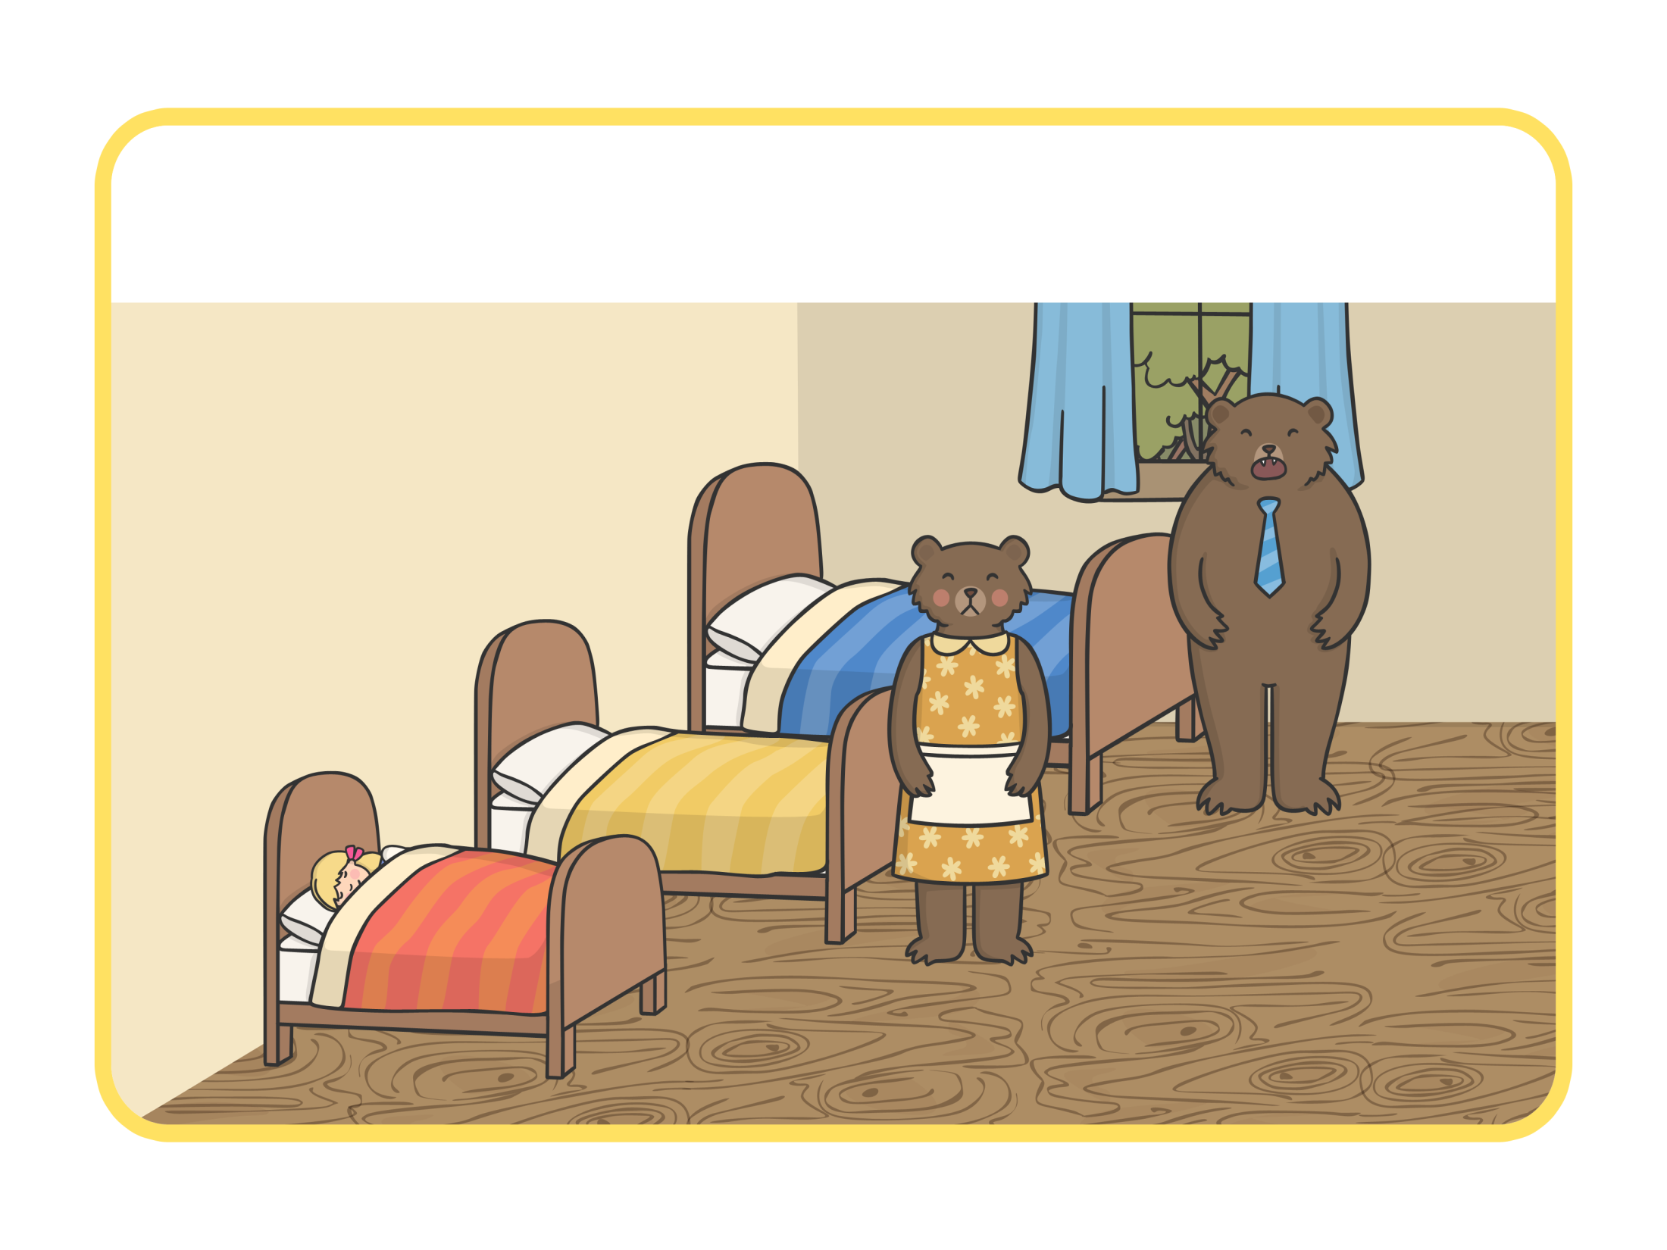
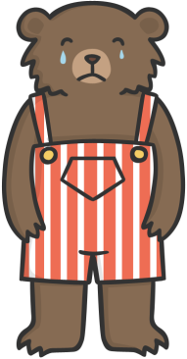
“Someone’s been sleeping in my bed, and she’s still there!” cried Baby Bear.

Slide 27
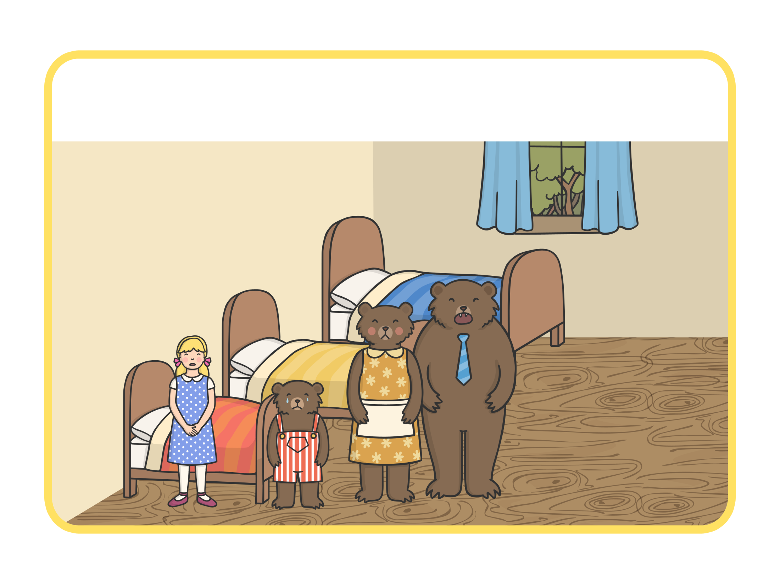
Just then Goldilocks woke up and saw The Three Bears. “Help!” she screamed.

Slide 28
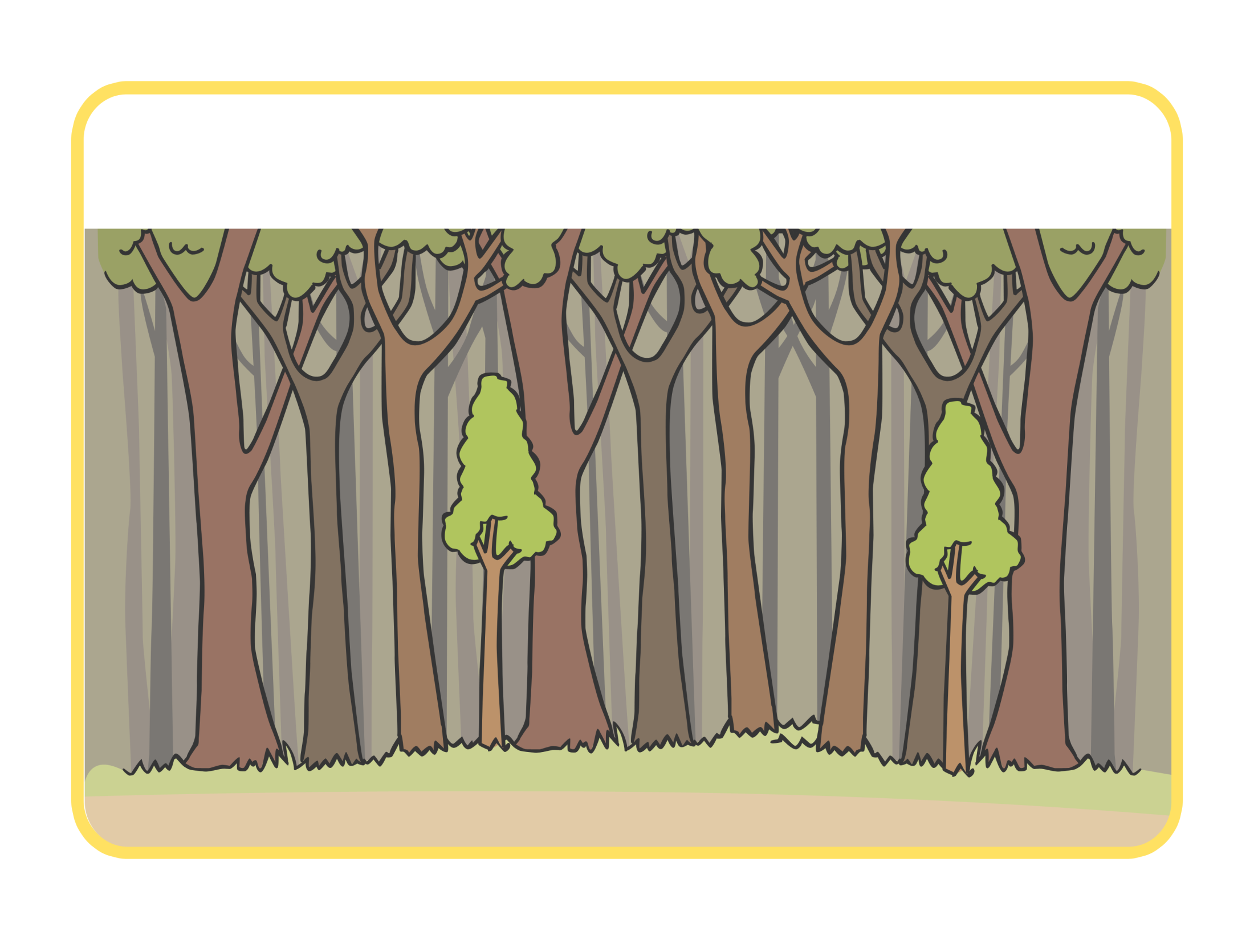
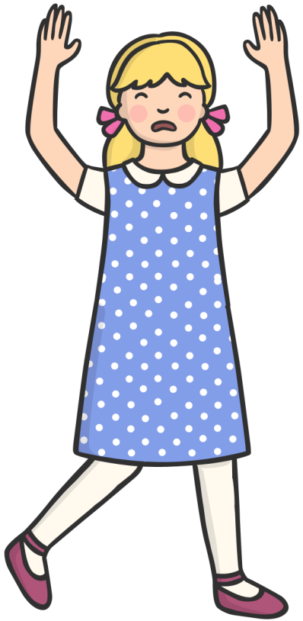
Goldilocks ran down the stairs and into the forest. And she never went back into the woods again.

Slide 29
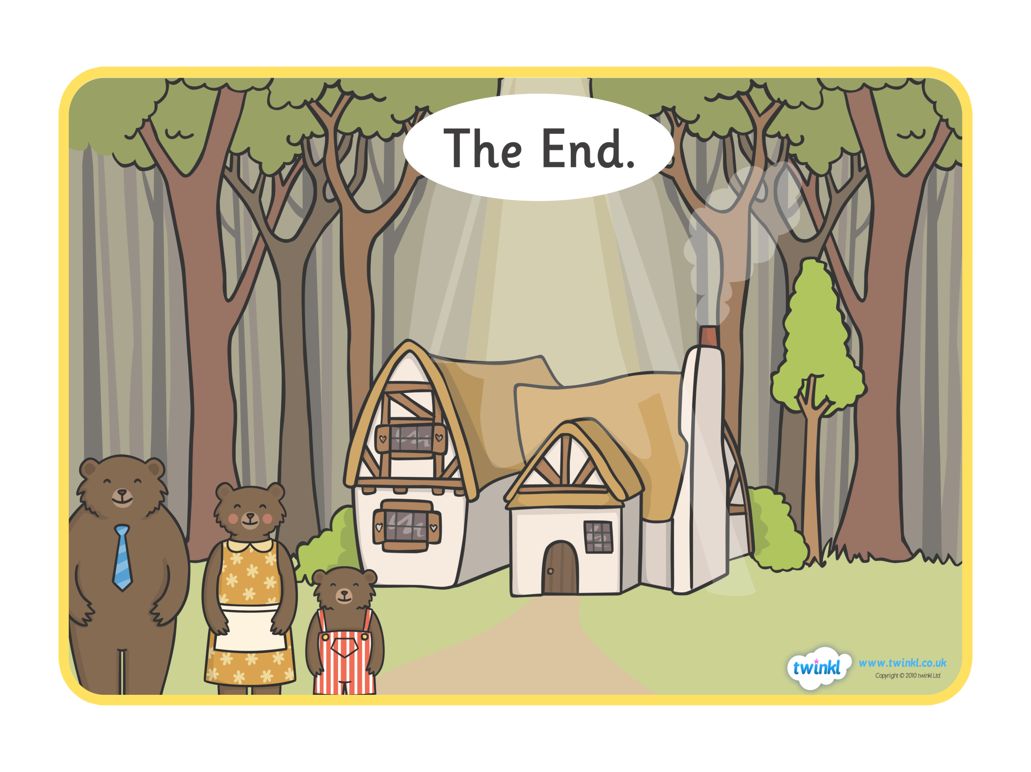
The End.

