Slide 1


Key Learning: To find the total of a set of coins
80p
20p
16p
30p
10p
30p
Y2 U10 L3 Talk Task

Slide 2


Key Learning: To find the total of a set of coins
True or false?
25p
41p
95p
40p
35p
90p
Y2 U10 L3 Task

Slide 3


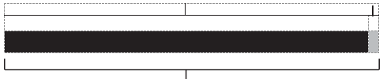
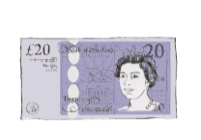

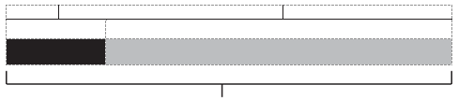


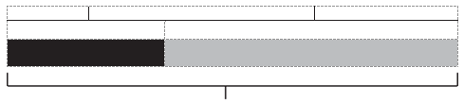
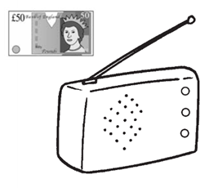
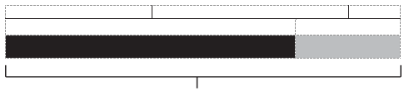
Key Learning: To work out change in pounds and pence
I went to the supermarket and I bought a comic that cost 99p. I gave the shopkeeper a £1 coin. How much change did I receive?
I went to the supermarket and I bought a book that cost £4. I gave the shopkeeper a £20 note. How much change did I receive?
I went to the supermarket and I bought a packet of sweets that cost 17p. I gave the shopkeeper a 50p coin. How much change did I receive?
I went to the supermarket and I bought a radio that cost £39. I gave the shopkeeper a £50 note. How much change did I receive?
99
?
100
4
?
20
17
?
50
39
?
50
Y2 U10 L7 Task

