Slide 1
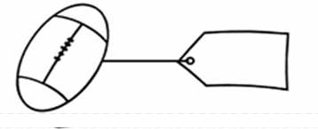
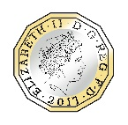
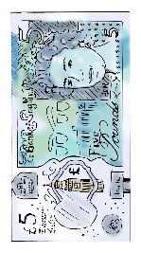
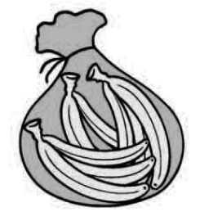


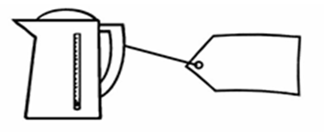
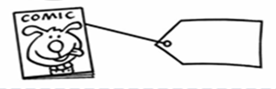

Key Learning: To recognise the value of coins and notes and use the £ symbol accurately
Fill in the price labels. Use the signs <, > or = to fill in the circles.
>
<
Y2 U10 L2 Task

