Slide 1

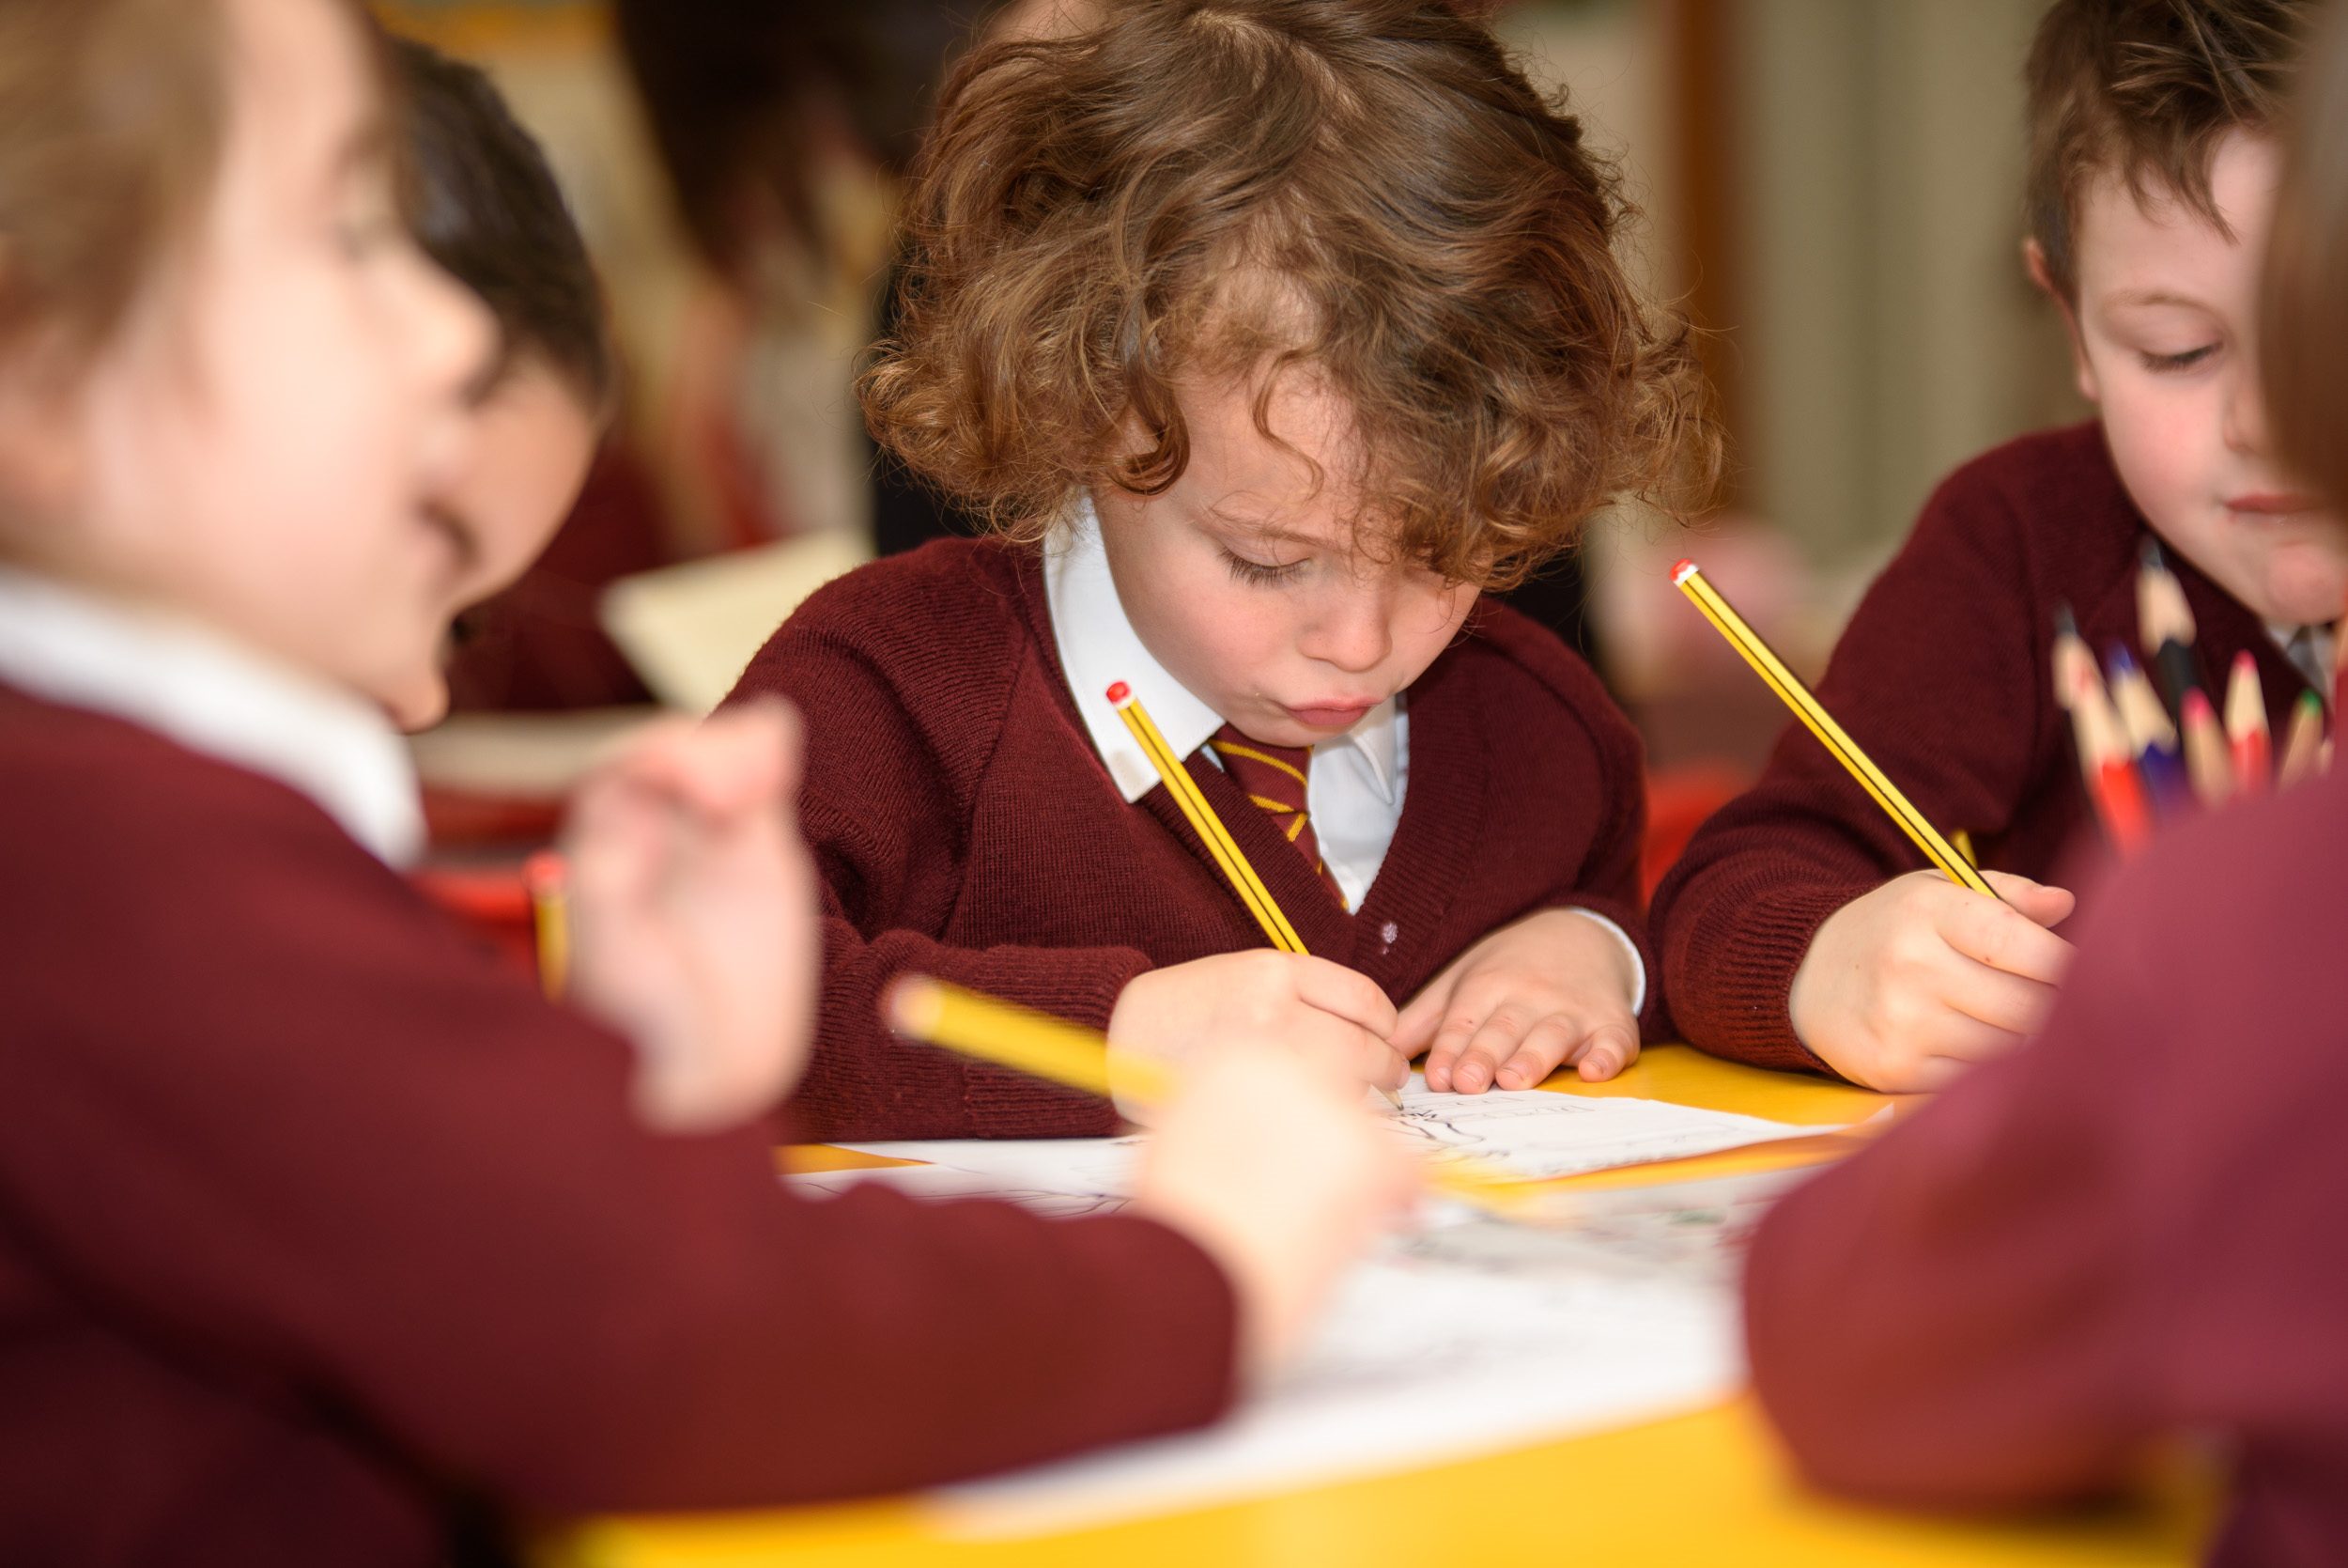
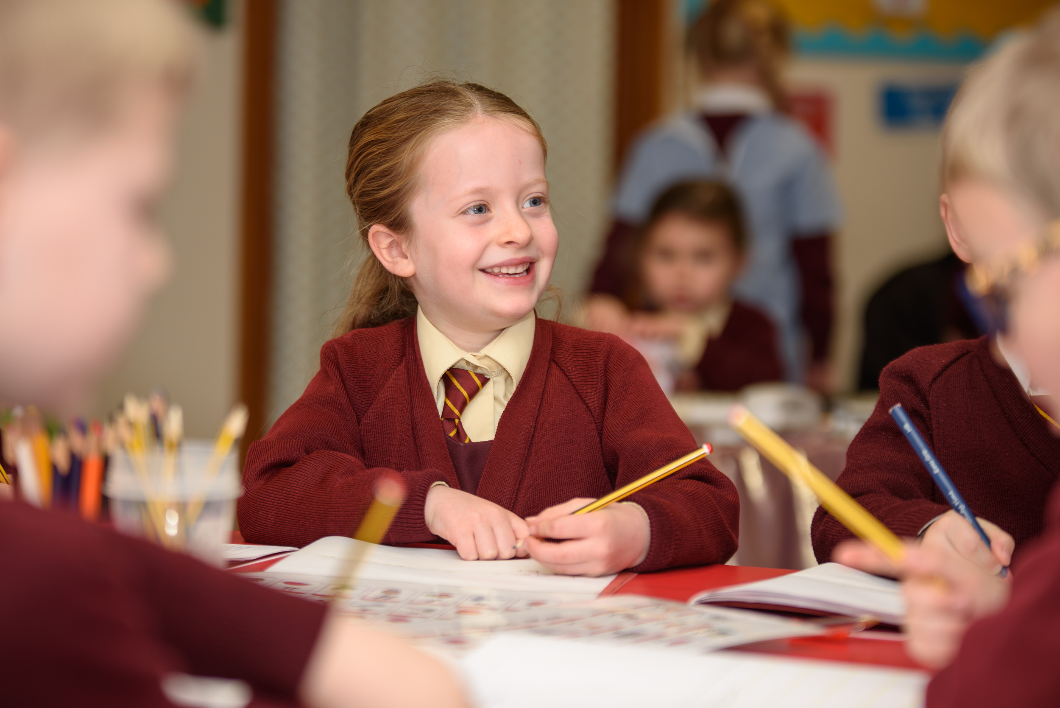
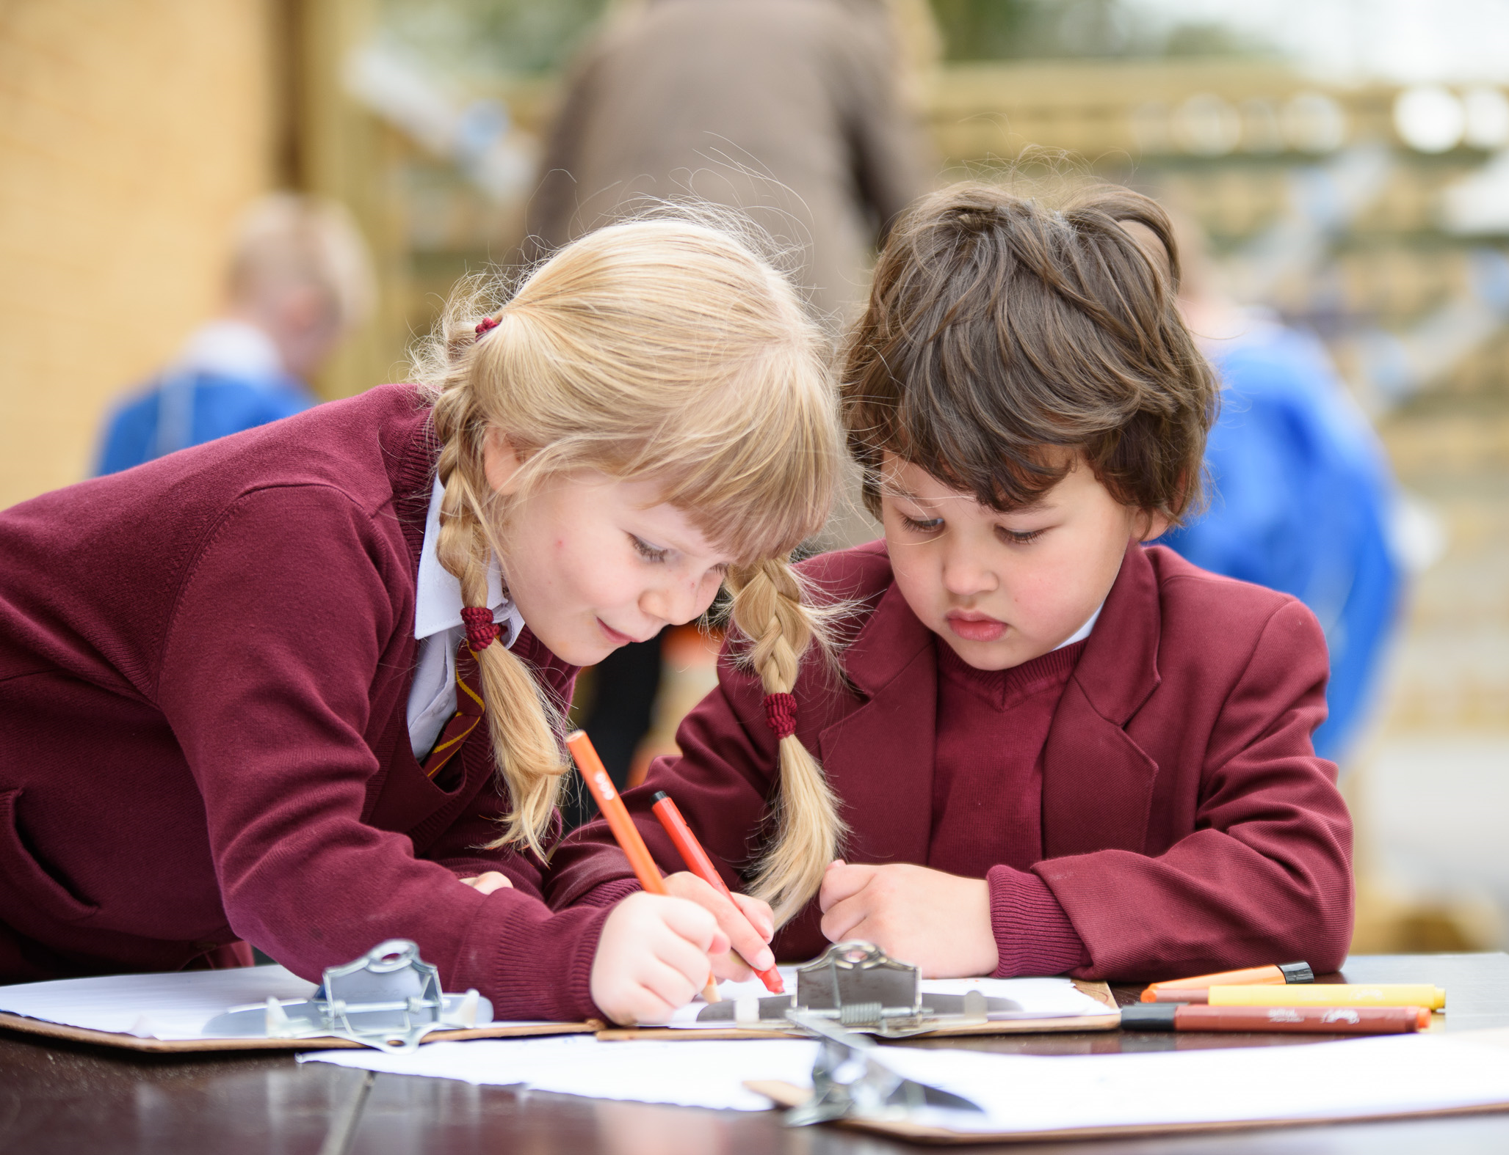
Letters and Sounds
A guide to phonics at Ramsgate Holy Trinity C.E (Aided) Primary School

Slide 2
What is Letters and Sounds?
Letters and Sounds is a phonics resource published by the Department for Education (DfE). It aims to build children's speaking and listening skills, as well as preparing children to read, by developing their phonic knowledge. It sets out a detailed and systematic programme with the aim of all children becoming fluent readers and accurate spellers by the end of Key Stage 1.

Slide 3







Letters and Sounds
The programme is divided into six phases. During the programme new skills are taught, continually building on previous learning.

Slide 4
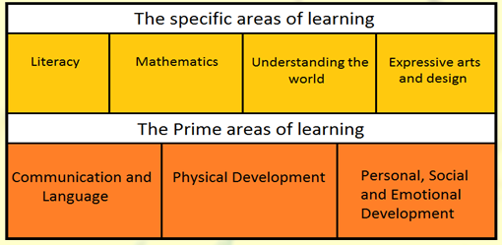
Phase 1
This phase is taught primarily in Nurseries and at the very beginning of the Reception year. It falls within the Communication, Language and Literacy area of learning in the Early Years Foundation Stage Curriculum.
During this phase, children are exposed to a language-rich environment and are taught the basic elements of blending and segmenting.

Slide 5
Oral Blending and Segmenting
These are two very important skills that early readers must develop. At first an adult will model how this is done, but continuous practice will enable children to do this independently.
Blending involves pulling together individual sounds or syllables within words. For example: m-a-n man.
Segmenting involves breaking words down into individual sounds or syllables. For example: dog d-o-g.

Slide 6
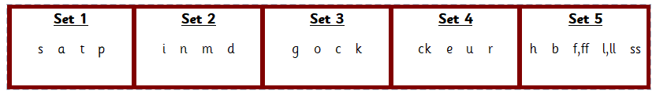
Phase 2
This phase typically takes place in the Autumn term of Reception and it builds upon the oral blending and segmenting of the previous phase. Children will continue to practise what they have learnt. They will also be taught the grapheme - phoneme representations for the letters listed below.

Slide 7
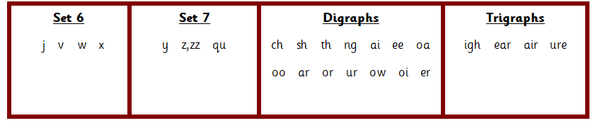
Phase 3
This phase is usually taught during the Spring and Summer term of Reception. The purpose of this phase is to teach the children the remaining letters of the alphabet and some sounds of which are made up of two or three letters. These are known as digraphs and trigraphs. The sounds listed in the table below are taught in phase 3.

Slide 8




Phase 4
This phase is taught at the very beginning of Year One and is used to consolidate the sounds previously taught in phase 2 and 3. During this phase children will practise reading and writing a wide variety of words. They will also be exposed to adjacent consonants and multisyllabic words – words which have more than one syllable.
For example ‘nt’ as in tent, ‘st’ as in toast, ‘pl’ as in plum and ‘sp’ as in spoon.

Slide 9
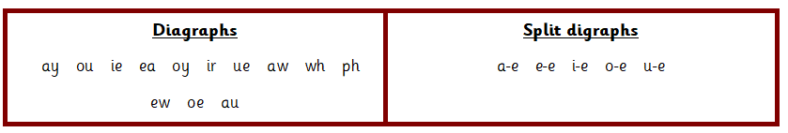
Phase 5
This phase is typically taught in Year One. The purpose of this phase is to broaden the children’s knowledge of graphemes and phonemes for use in reading and spelling. When spelling words, the children will be expected to choose the correct graphemes to represent the right phonemes. For example, the word cloud is spelt with the phoneme ‘ou’ not ‘ow’.
The phonemes listed below are taught in phase 5.

Slide 10


Phase 6
This phase is usually taught in Year Two and when children enter this phase, they should now know most of the common phonemes, and as a result of this, they should be able to read hundreds of words. During this phase, the aim is for children to become fluent readers and accurate spellers. They will also be introduced to different prefixes (letters added to the beginnings of words) such as dis- or re- and suffixes (letters added to the ends of words) such as -ful, -less, -ment.

Slide 11
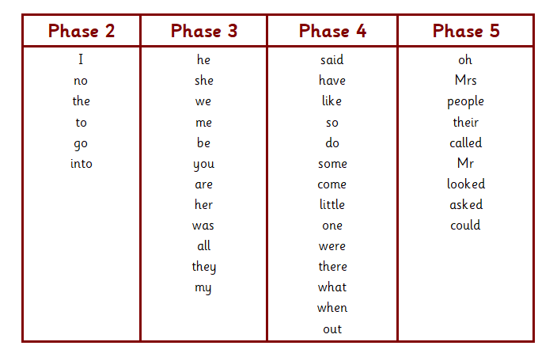
Tricky Words
Throughout the different phases these ‘Tricky Words’ are taught to the children. These are words which cannot be sounded out.

Slide 12
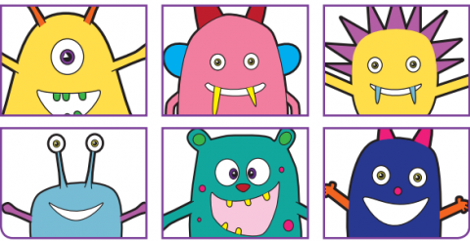
Year One
Phonic Screening Check
This takes place in Year One during the Summer term. The children are asked to read forty words, twenty real and twenty nonsense words. The phonic screening check is not about passing or failing, but checking appropriate progress is being made. The check will be completed by the class teacher and all parents/carers will be informed of their child’s score by the end of the school year.

Slide 13
What can I do at home?
Promoting a love for reading is paramount. There are many different ways this can be done from an early age:
Sing nursery rhymes from an early age. When your child is old enough, they can join in.
Share books regularly. Buy books or go to the local library. Read books by the same author and reread your child’s favourites.
Listen to your child read and remember to continue to read to them. It is important they are exposed to vocabulary beyond their reading ability.
Allow your child to see you reading for pleasure. It may be fiction or non-fiction.
Talk about books. Ask the children what is happening, how the characters are feeling and what they have enjoyed.
Use props and puppets to tell stories. Allow their imagination to run wild!
Make reading a pleasure, not a chore!

